Slide 1
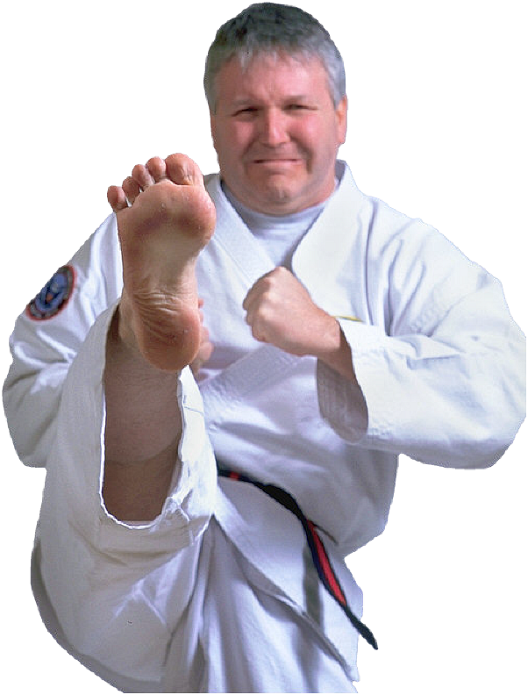
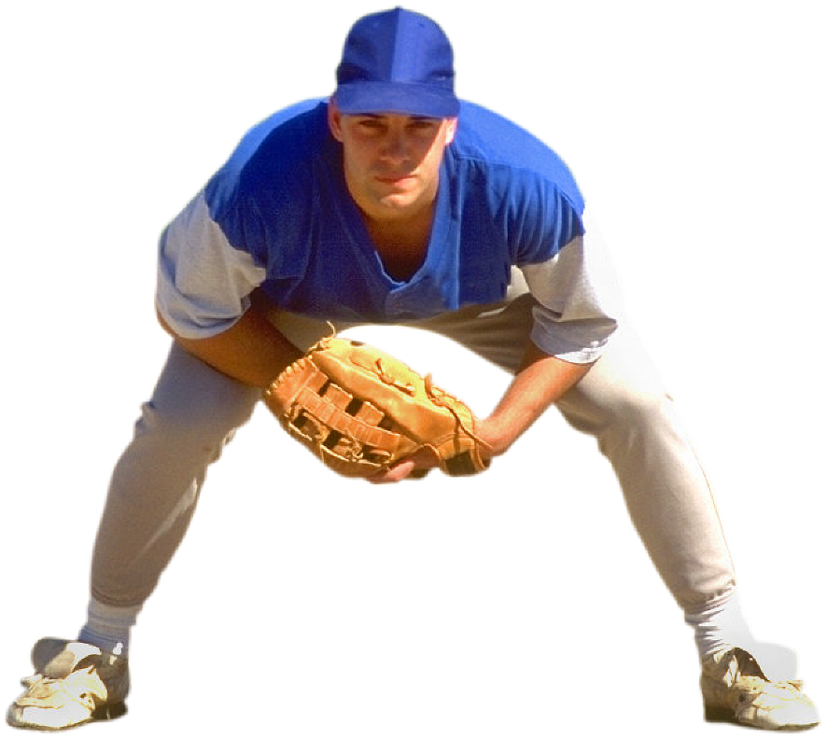
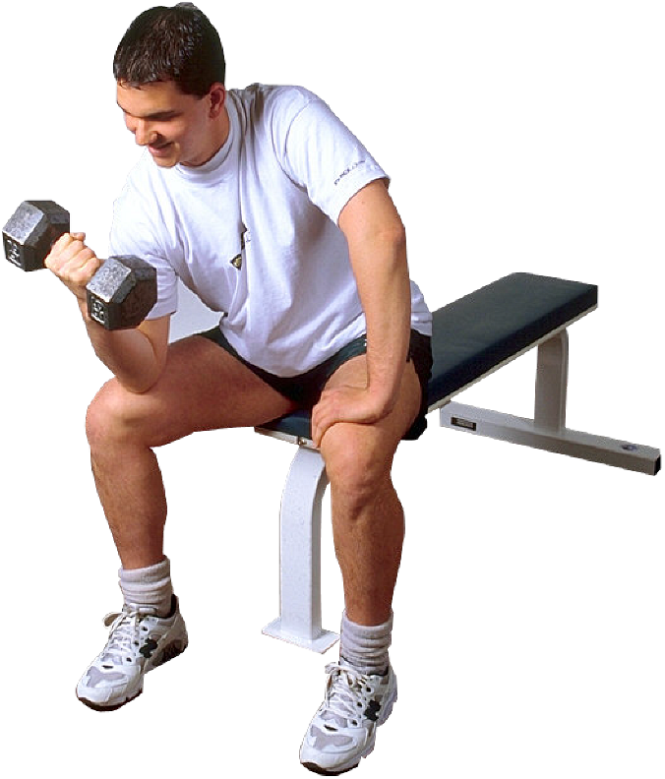


EL IMPACTO DE LAS CIENCIAS DEL MOVIMIENTO HUMANO, SALUD Y DEPORTE: en el Desarrollo del Emprendedor
Prof. Edgar Lopategui Corsino
M.A., Fisiología del Ejercicio
Web: http://www.saludmed.com/
E-Mail: elopateg@intermetro.edu
Artículo: http://www.saludmed.com/articulos/Emprendedorismo/
mueveemprendedor.html

Slide 2


Slide 3


Slide 4


Slide 5

BOSQUEJO
Introducción
Salud física para emprender
Rehabilitación del fracaso
Emprendedores en las ciencias del movimiento humano y deporte
Oportudidades de emprendimiento en las ciencias de la salud
Notes:
5

Slide 6
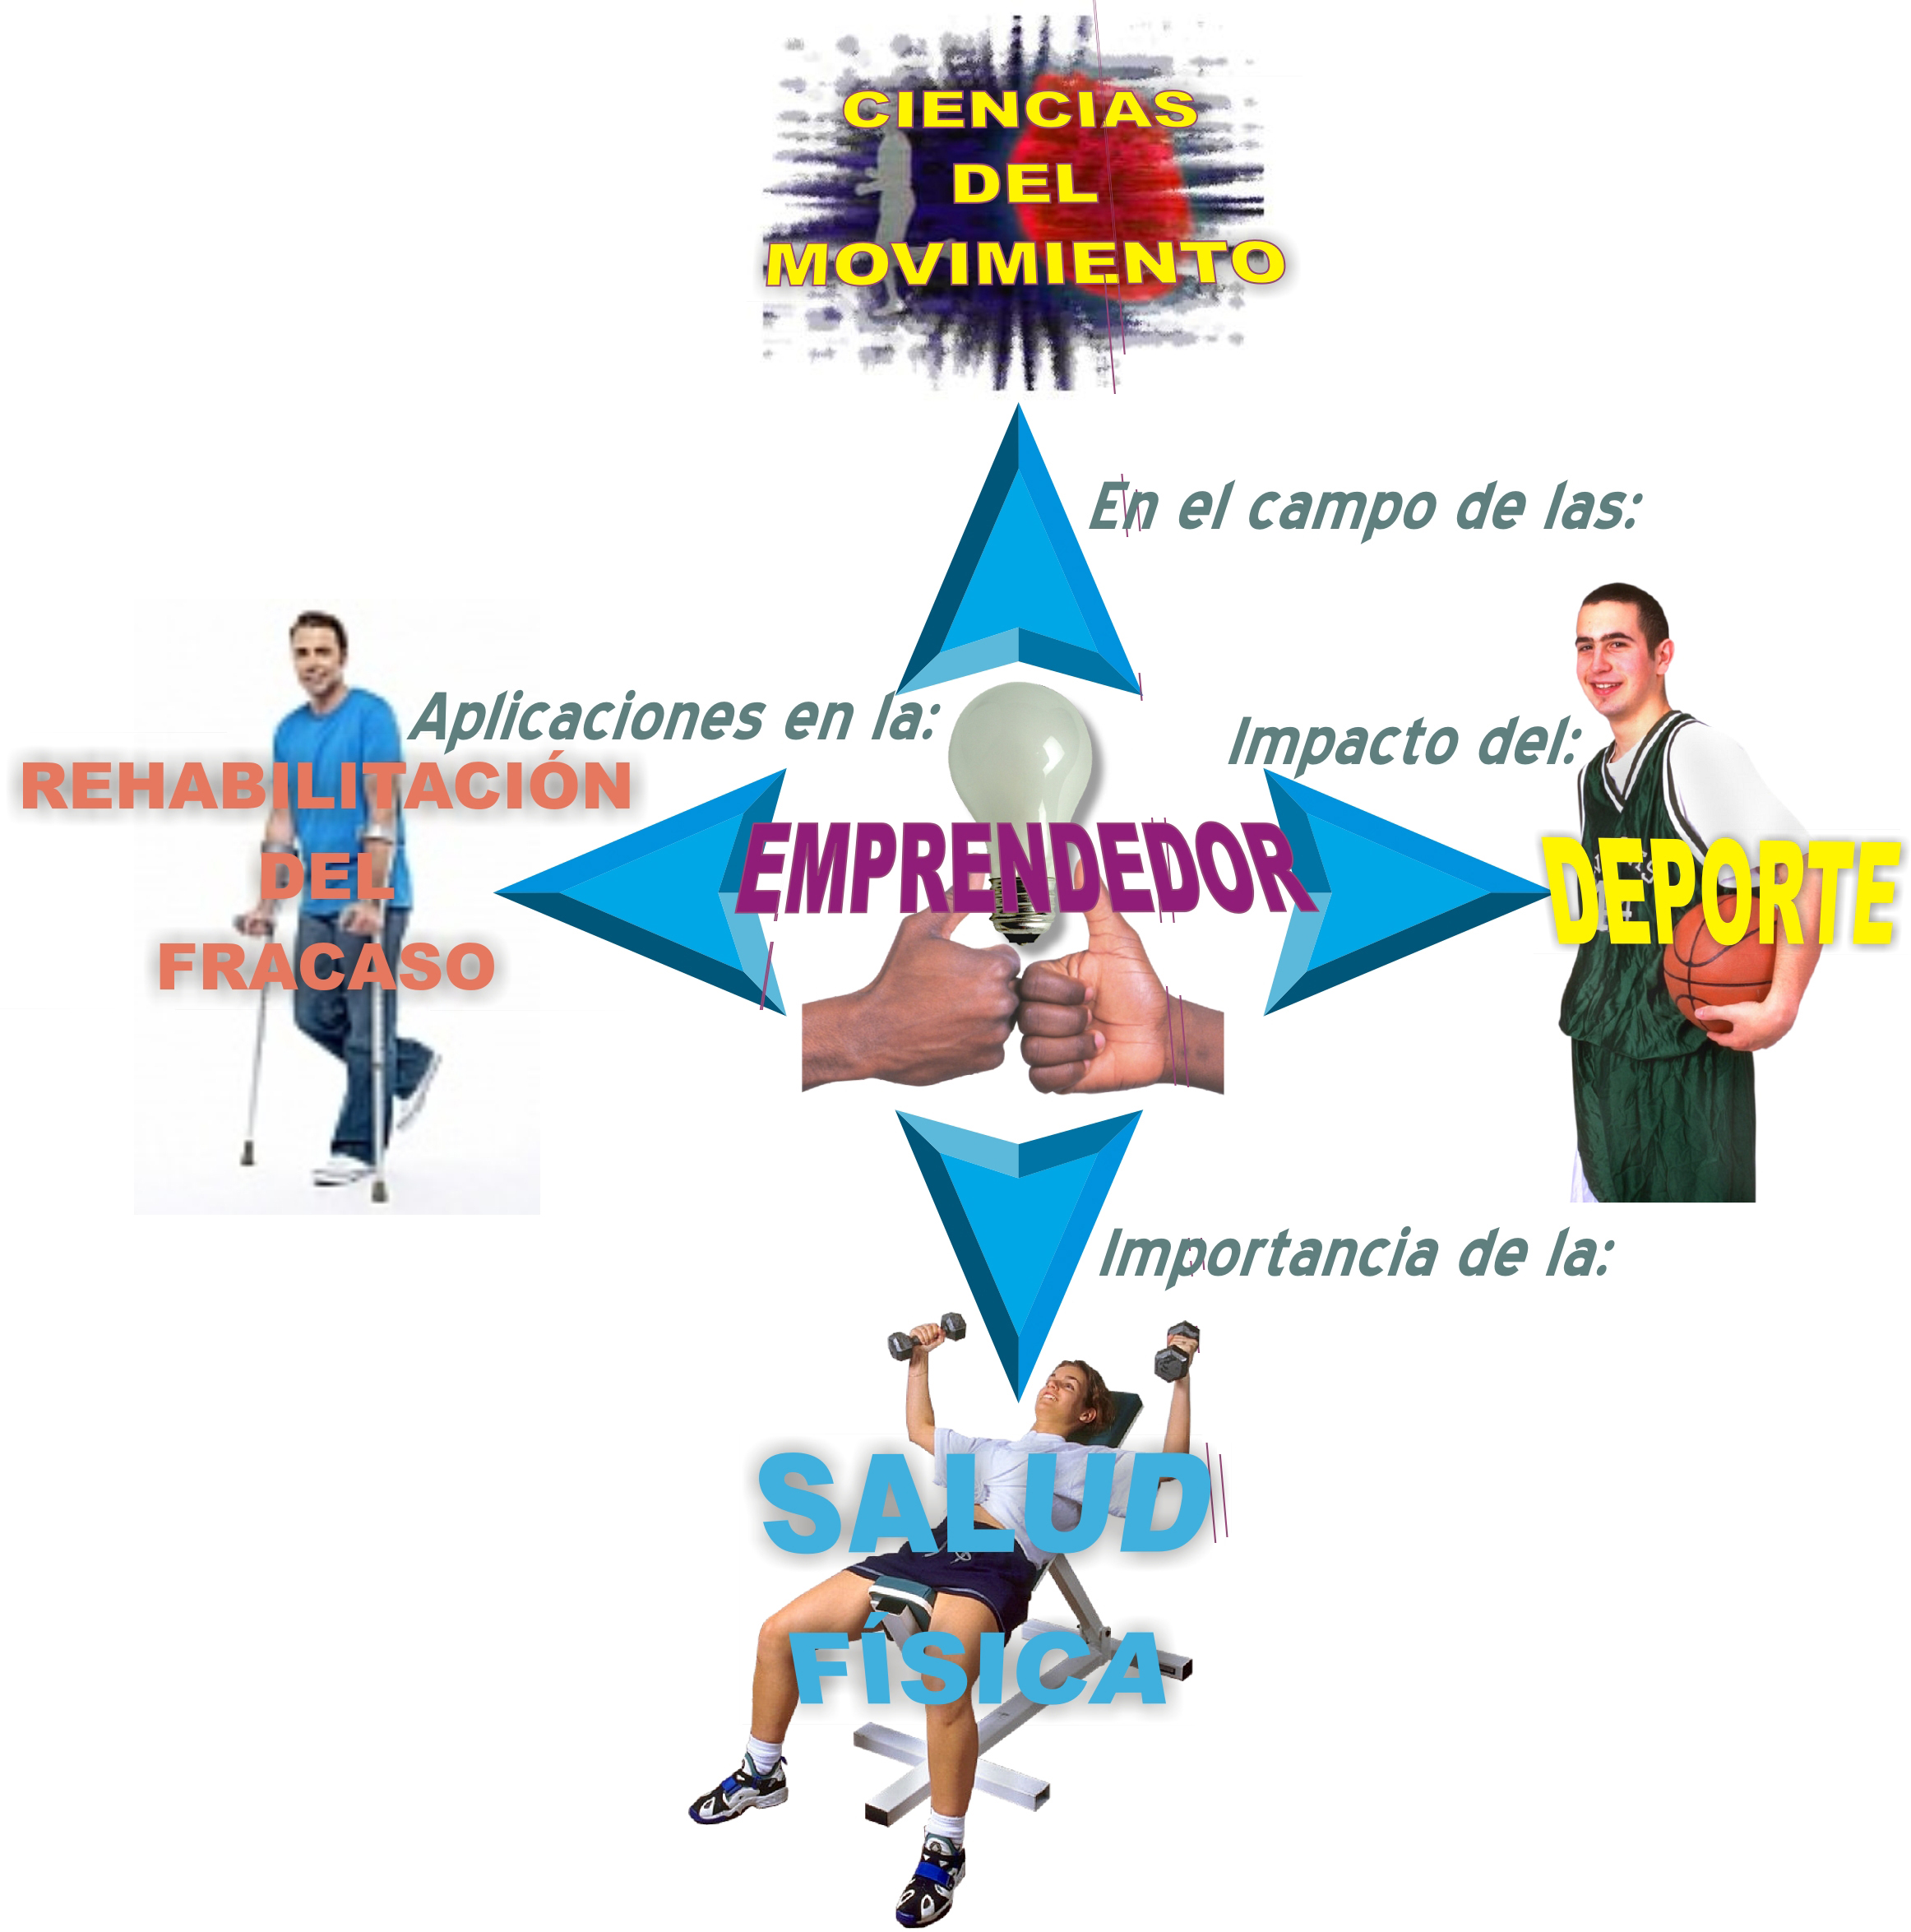
Notes:
6

Slide 7

Notes:
7

Slide 8
D
edicación: al entrenamiento físico/deportivo y competencia
E
esmero: para perfeccionar su ejecutoria competitiva
P
asión y perseverancia: para alcanzar la excelencia
O
portunidad: para ser un lider dentro y fuera del campo atlético
R
espeto: a sus rivales para una justa competencia
T
enacidad y resilencia: para tolerar y recuperse de los fracasos
E
emprendedor: para innovar y ser creativo en el escenario deportivo
Notes:
8

Slide 9
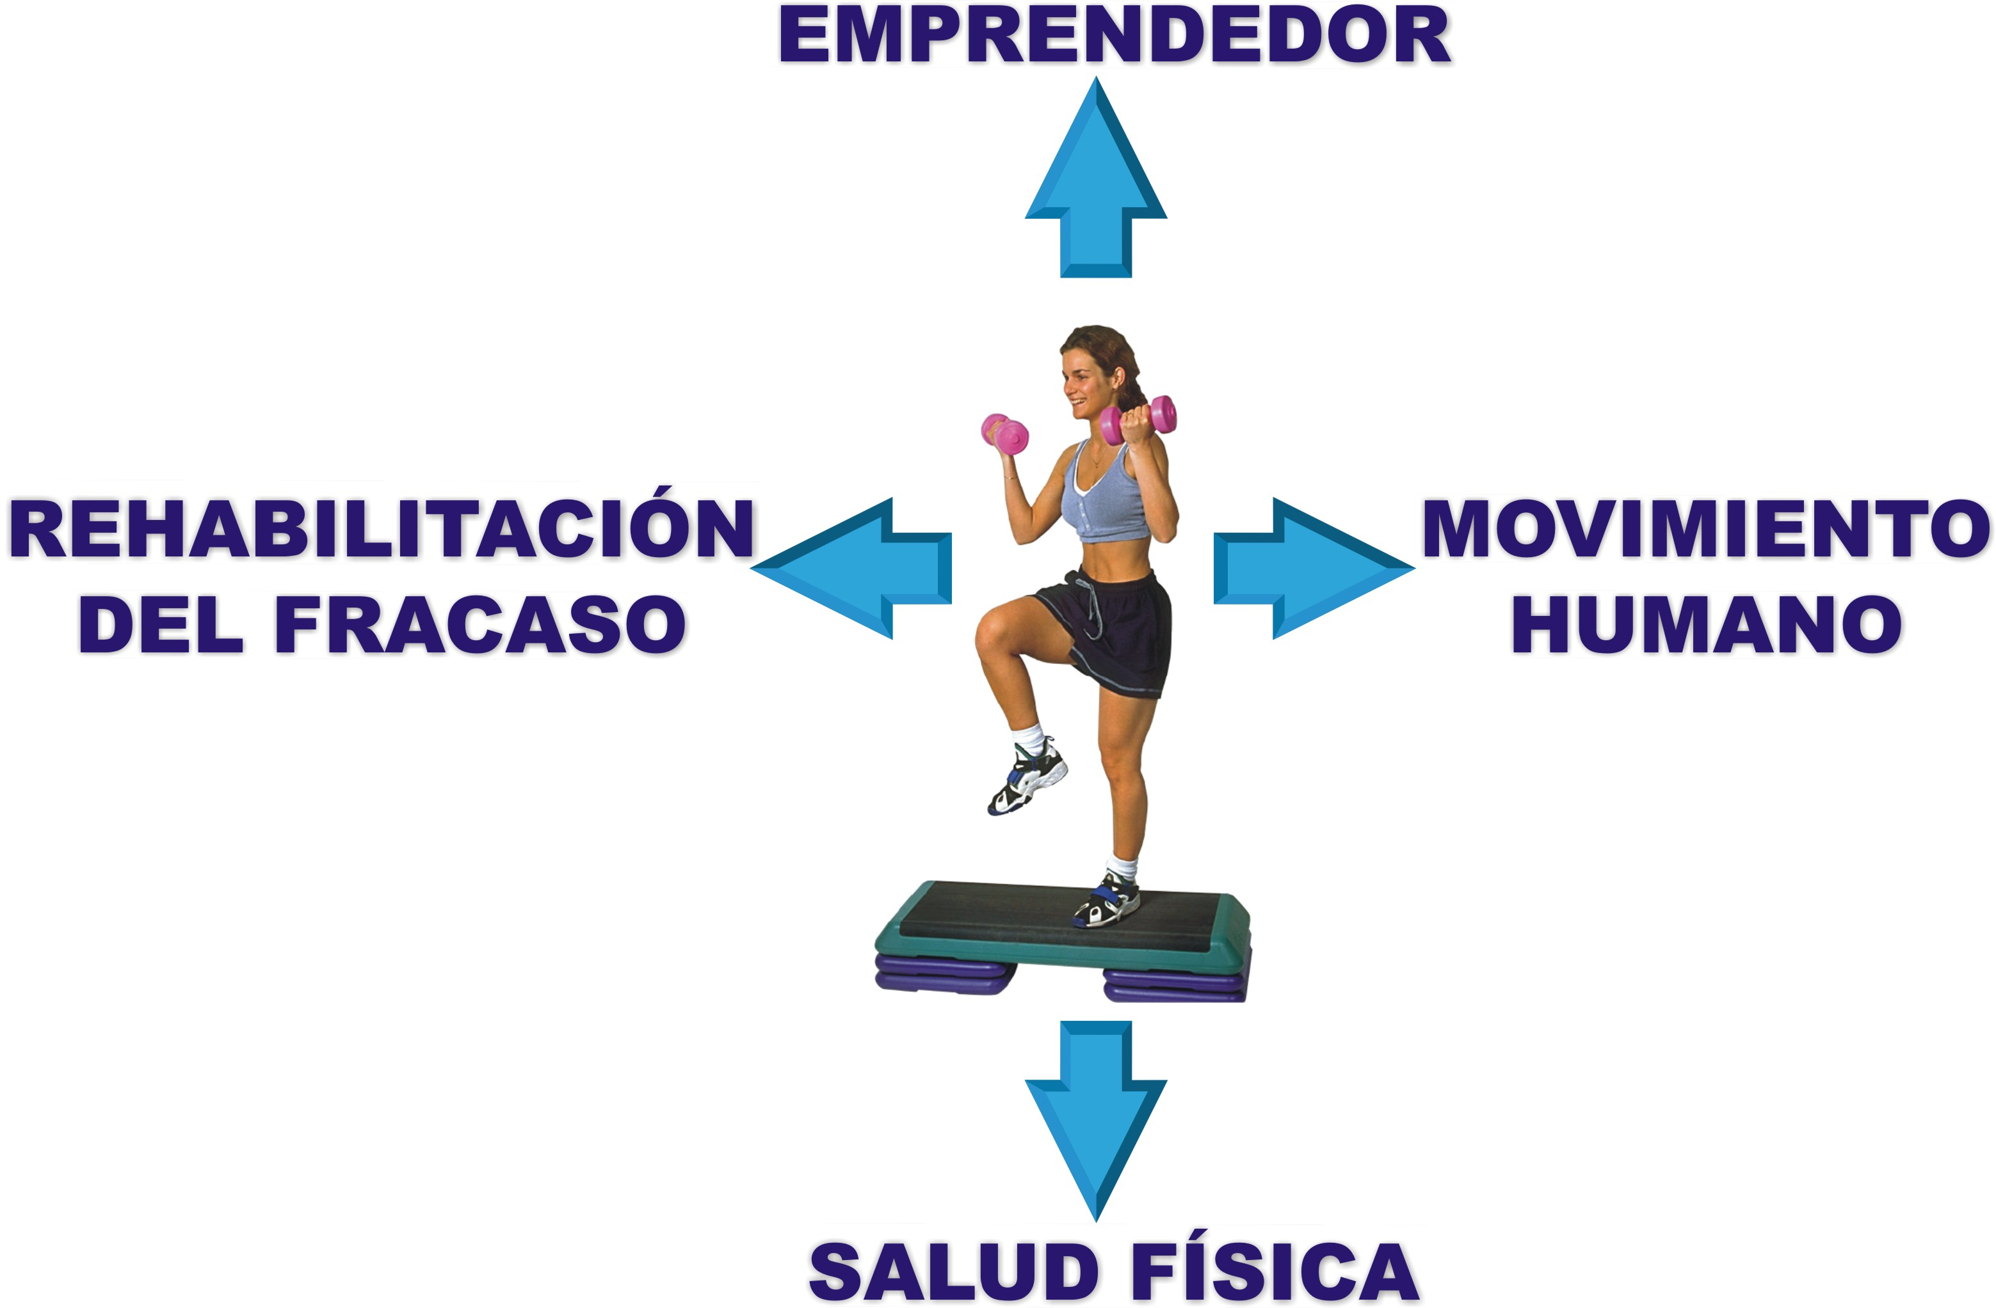
Notes:
9

Slide 10
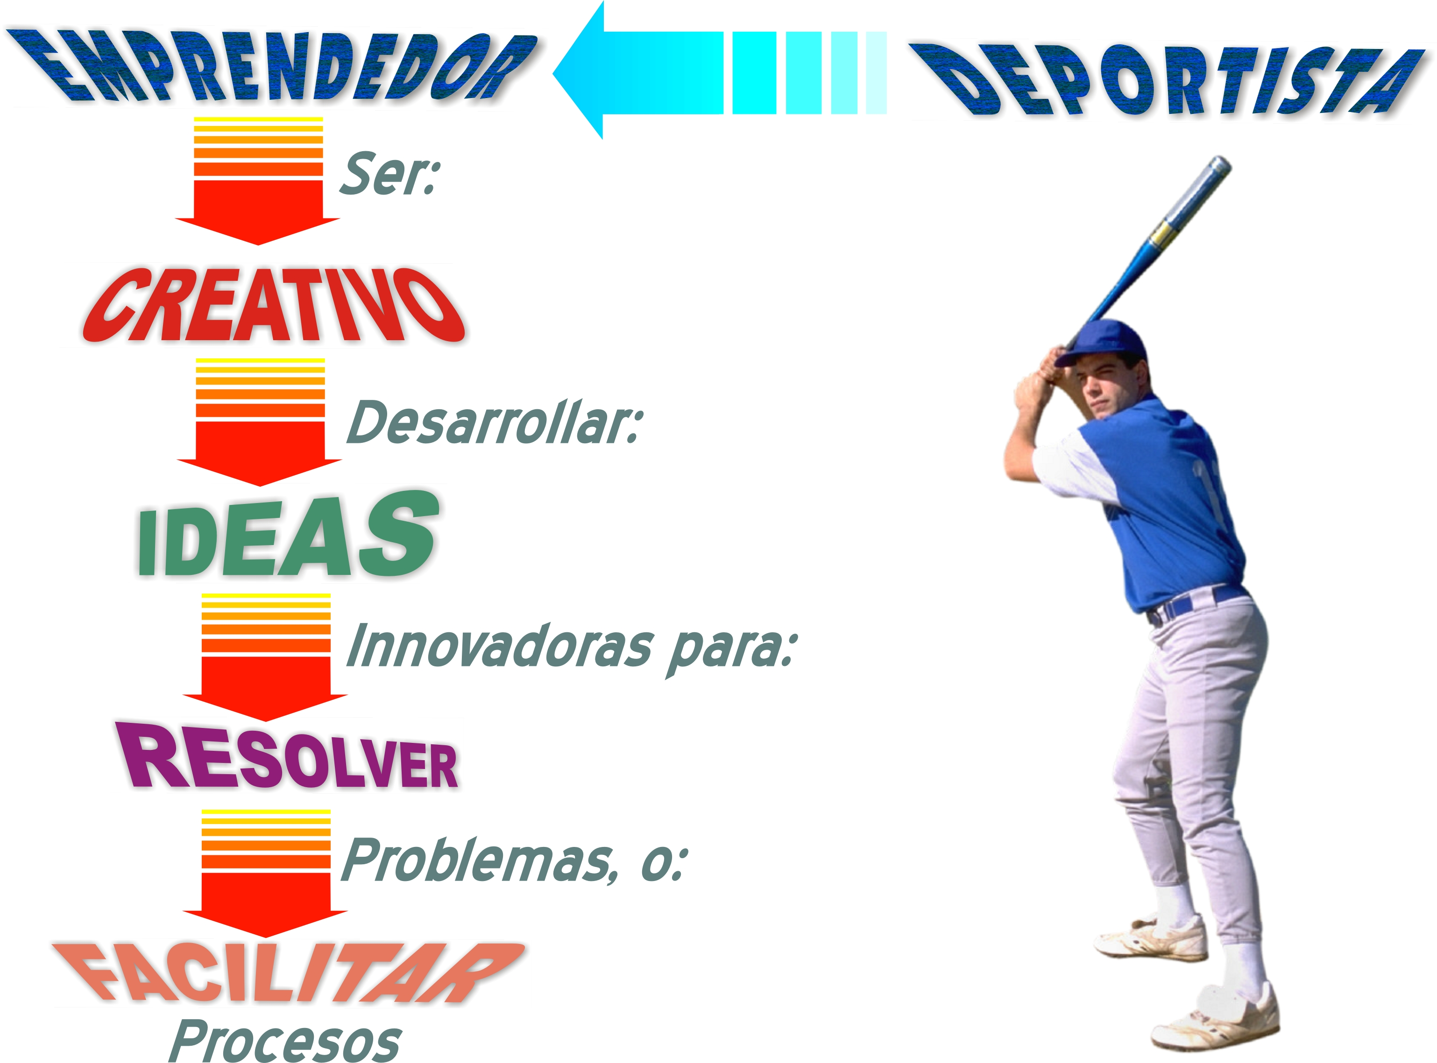
Notes:
10

Slide 11

Notes:
11

Slide 12
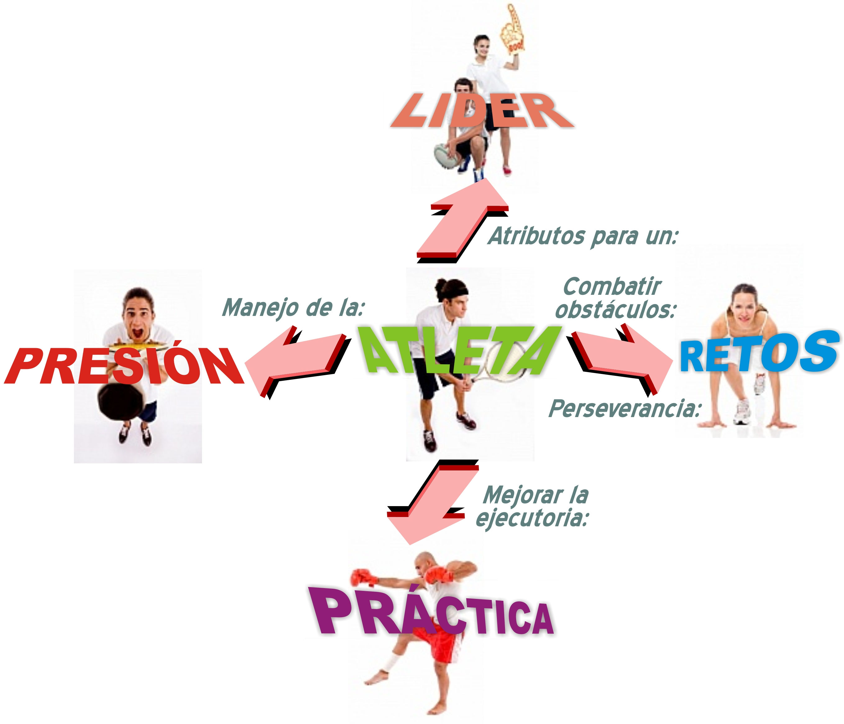
Notes:
12

Slide 13


Ratten, V. (2010). Developing a theory of sport-based entrepreneurship. Journal of Management Organization. 16(4), 557-565.
Notes:
13

Slide 14
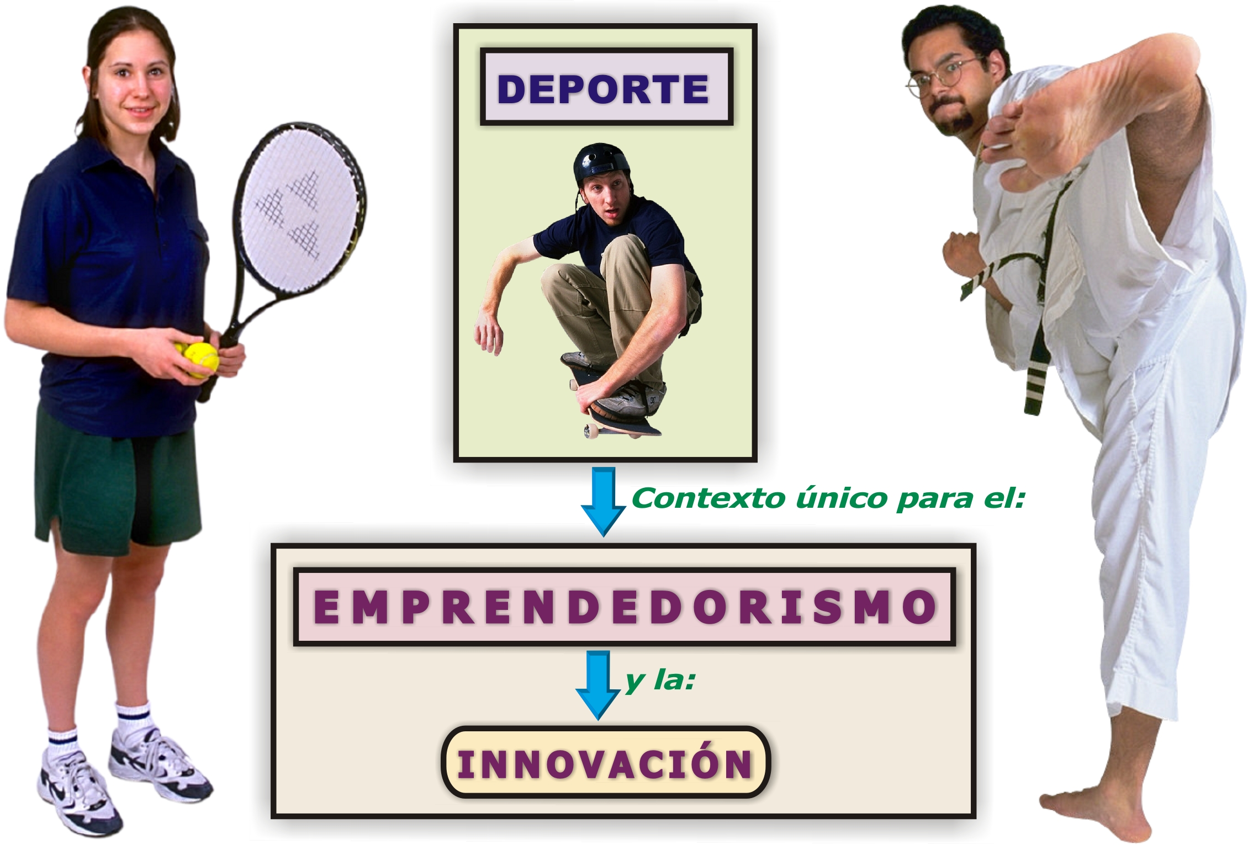
Notes:
14

Slide 15
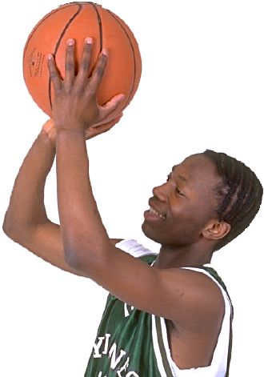
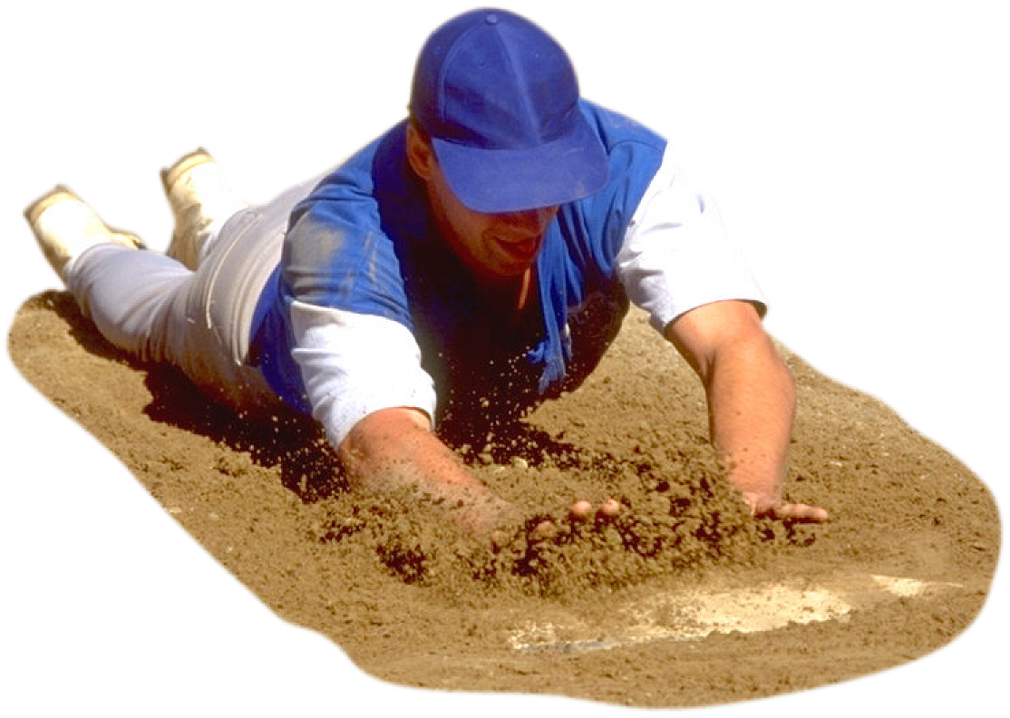
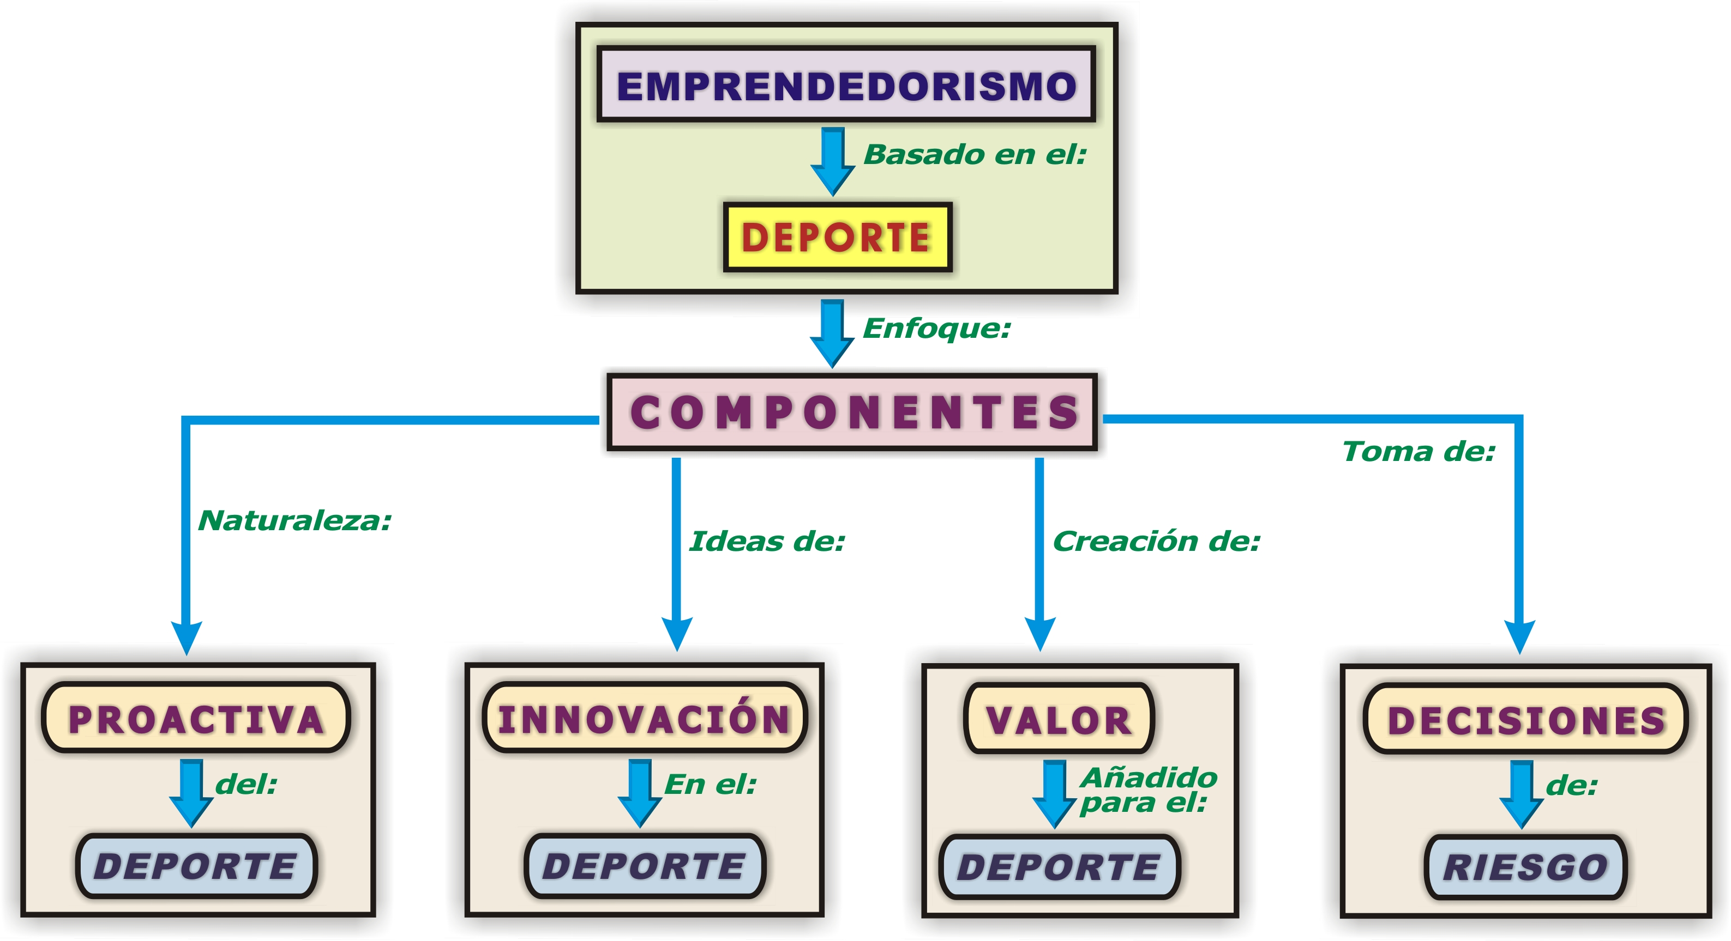
Notes:
15

Slide 16
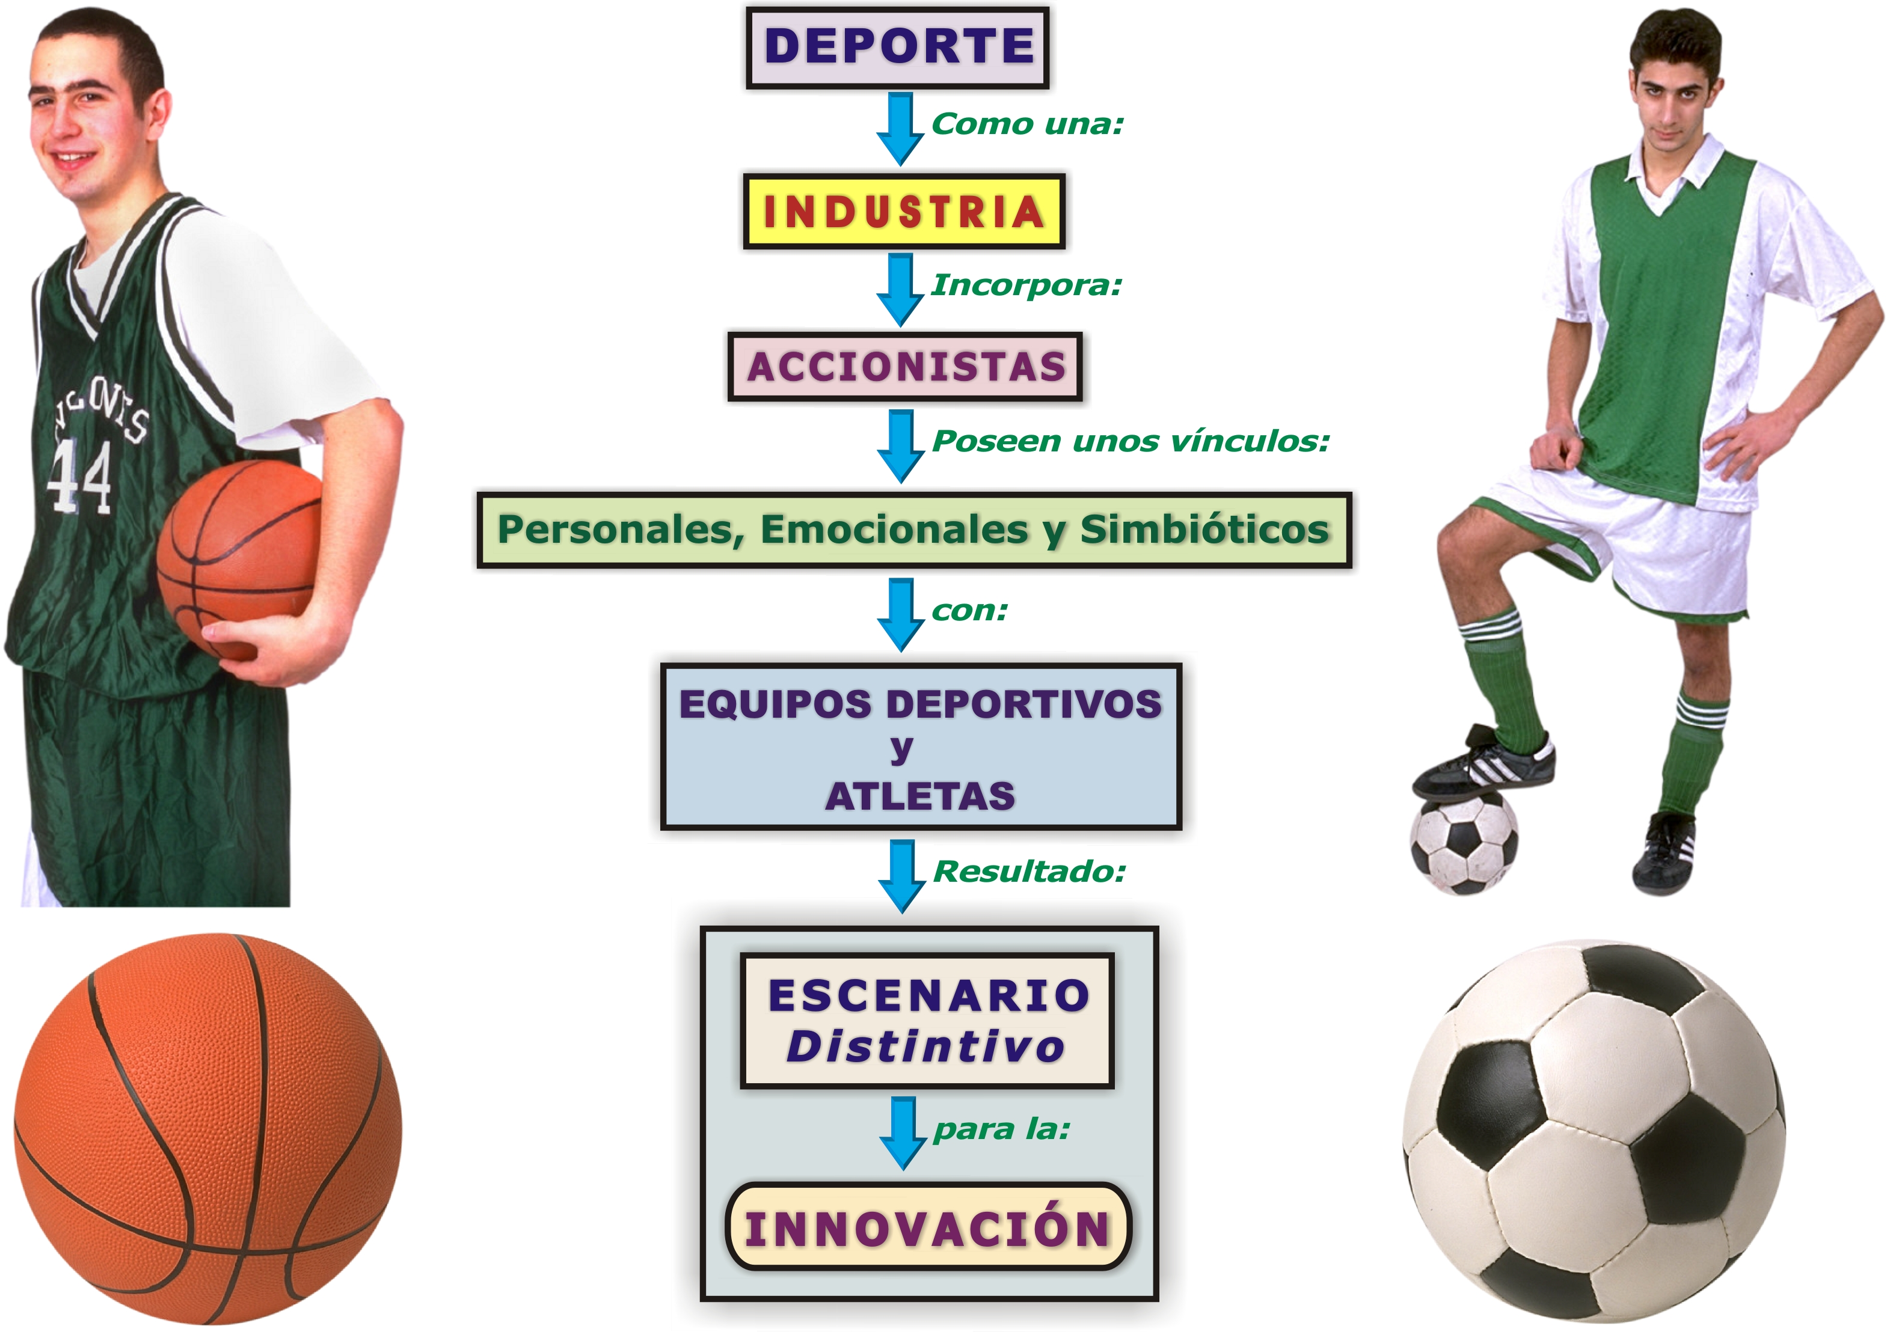
Notes:
16

Slide 17
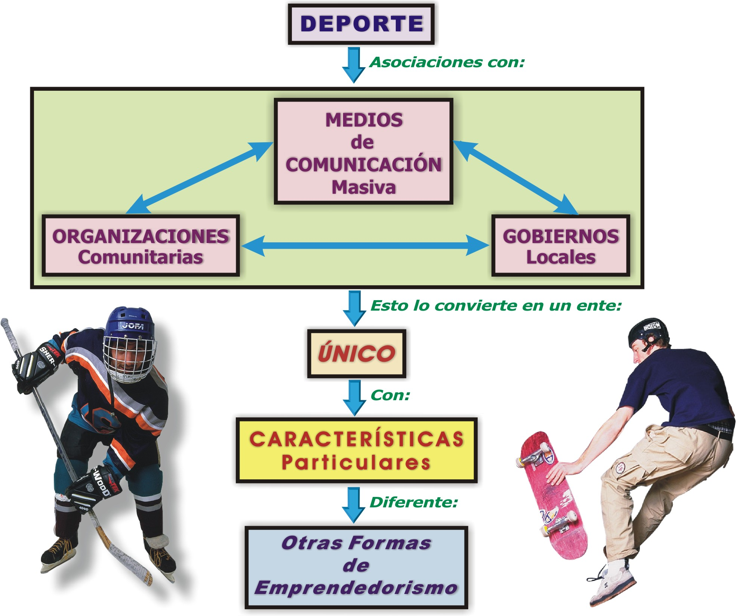
Notes:
17

Slide 18
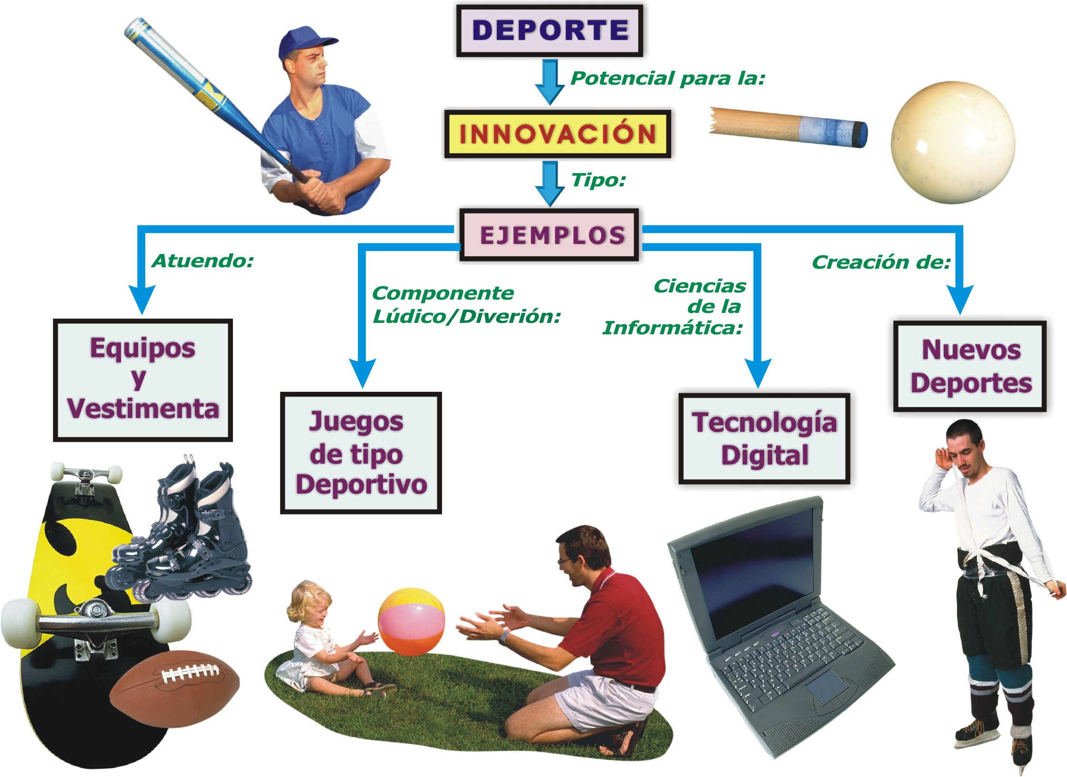
Notes:
18

Slide 19
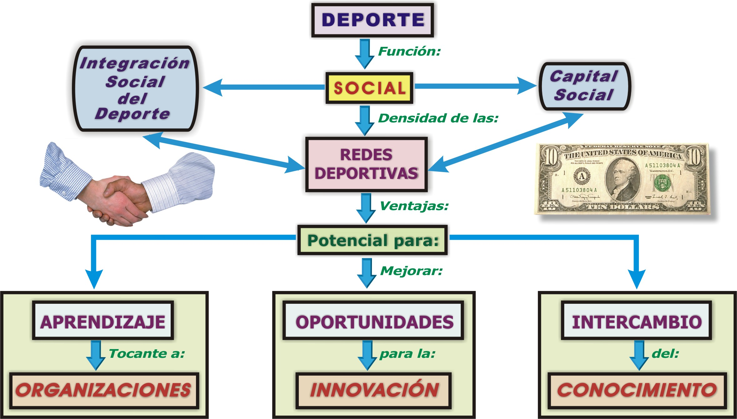
Notes:
19

Slide 20
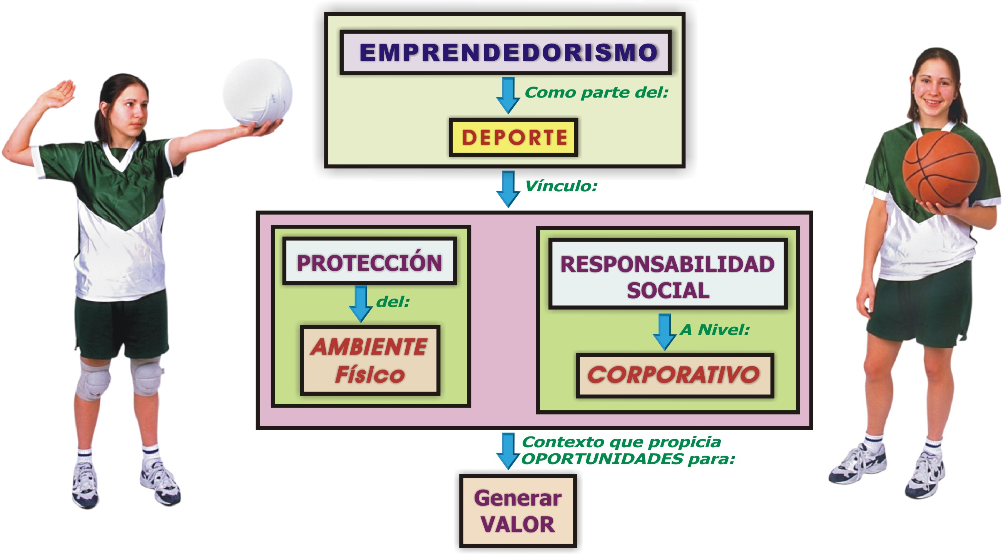
Notes:
20

Slide 21


Slide 22
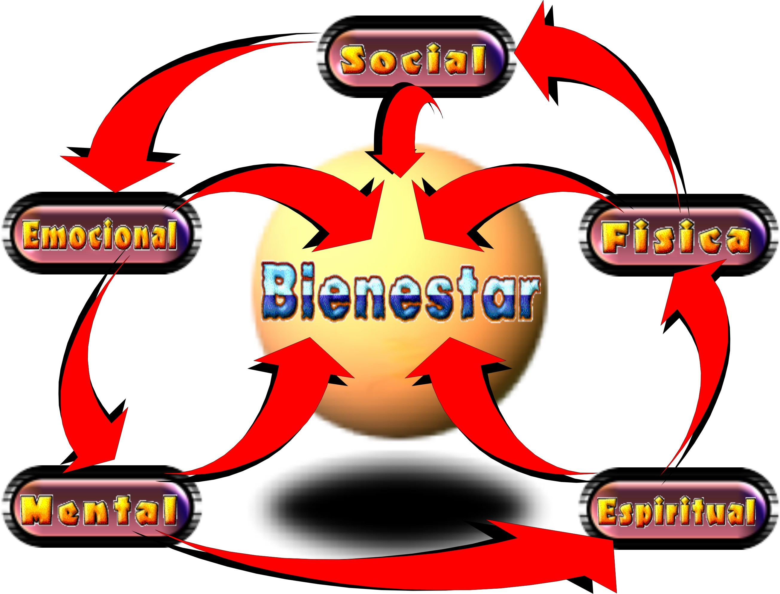
Notes:
22

Slide 23
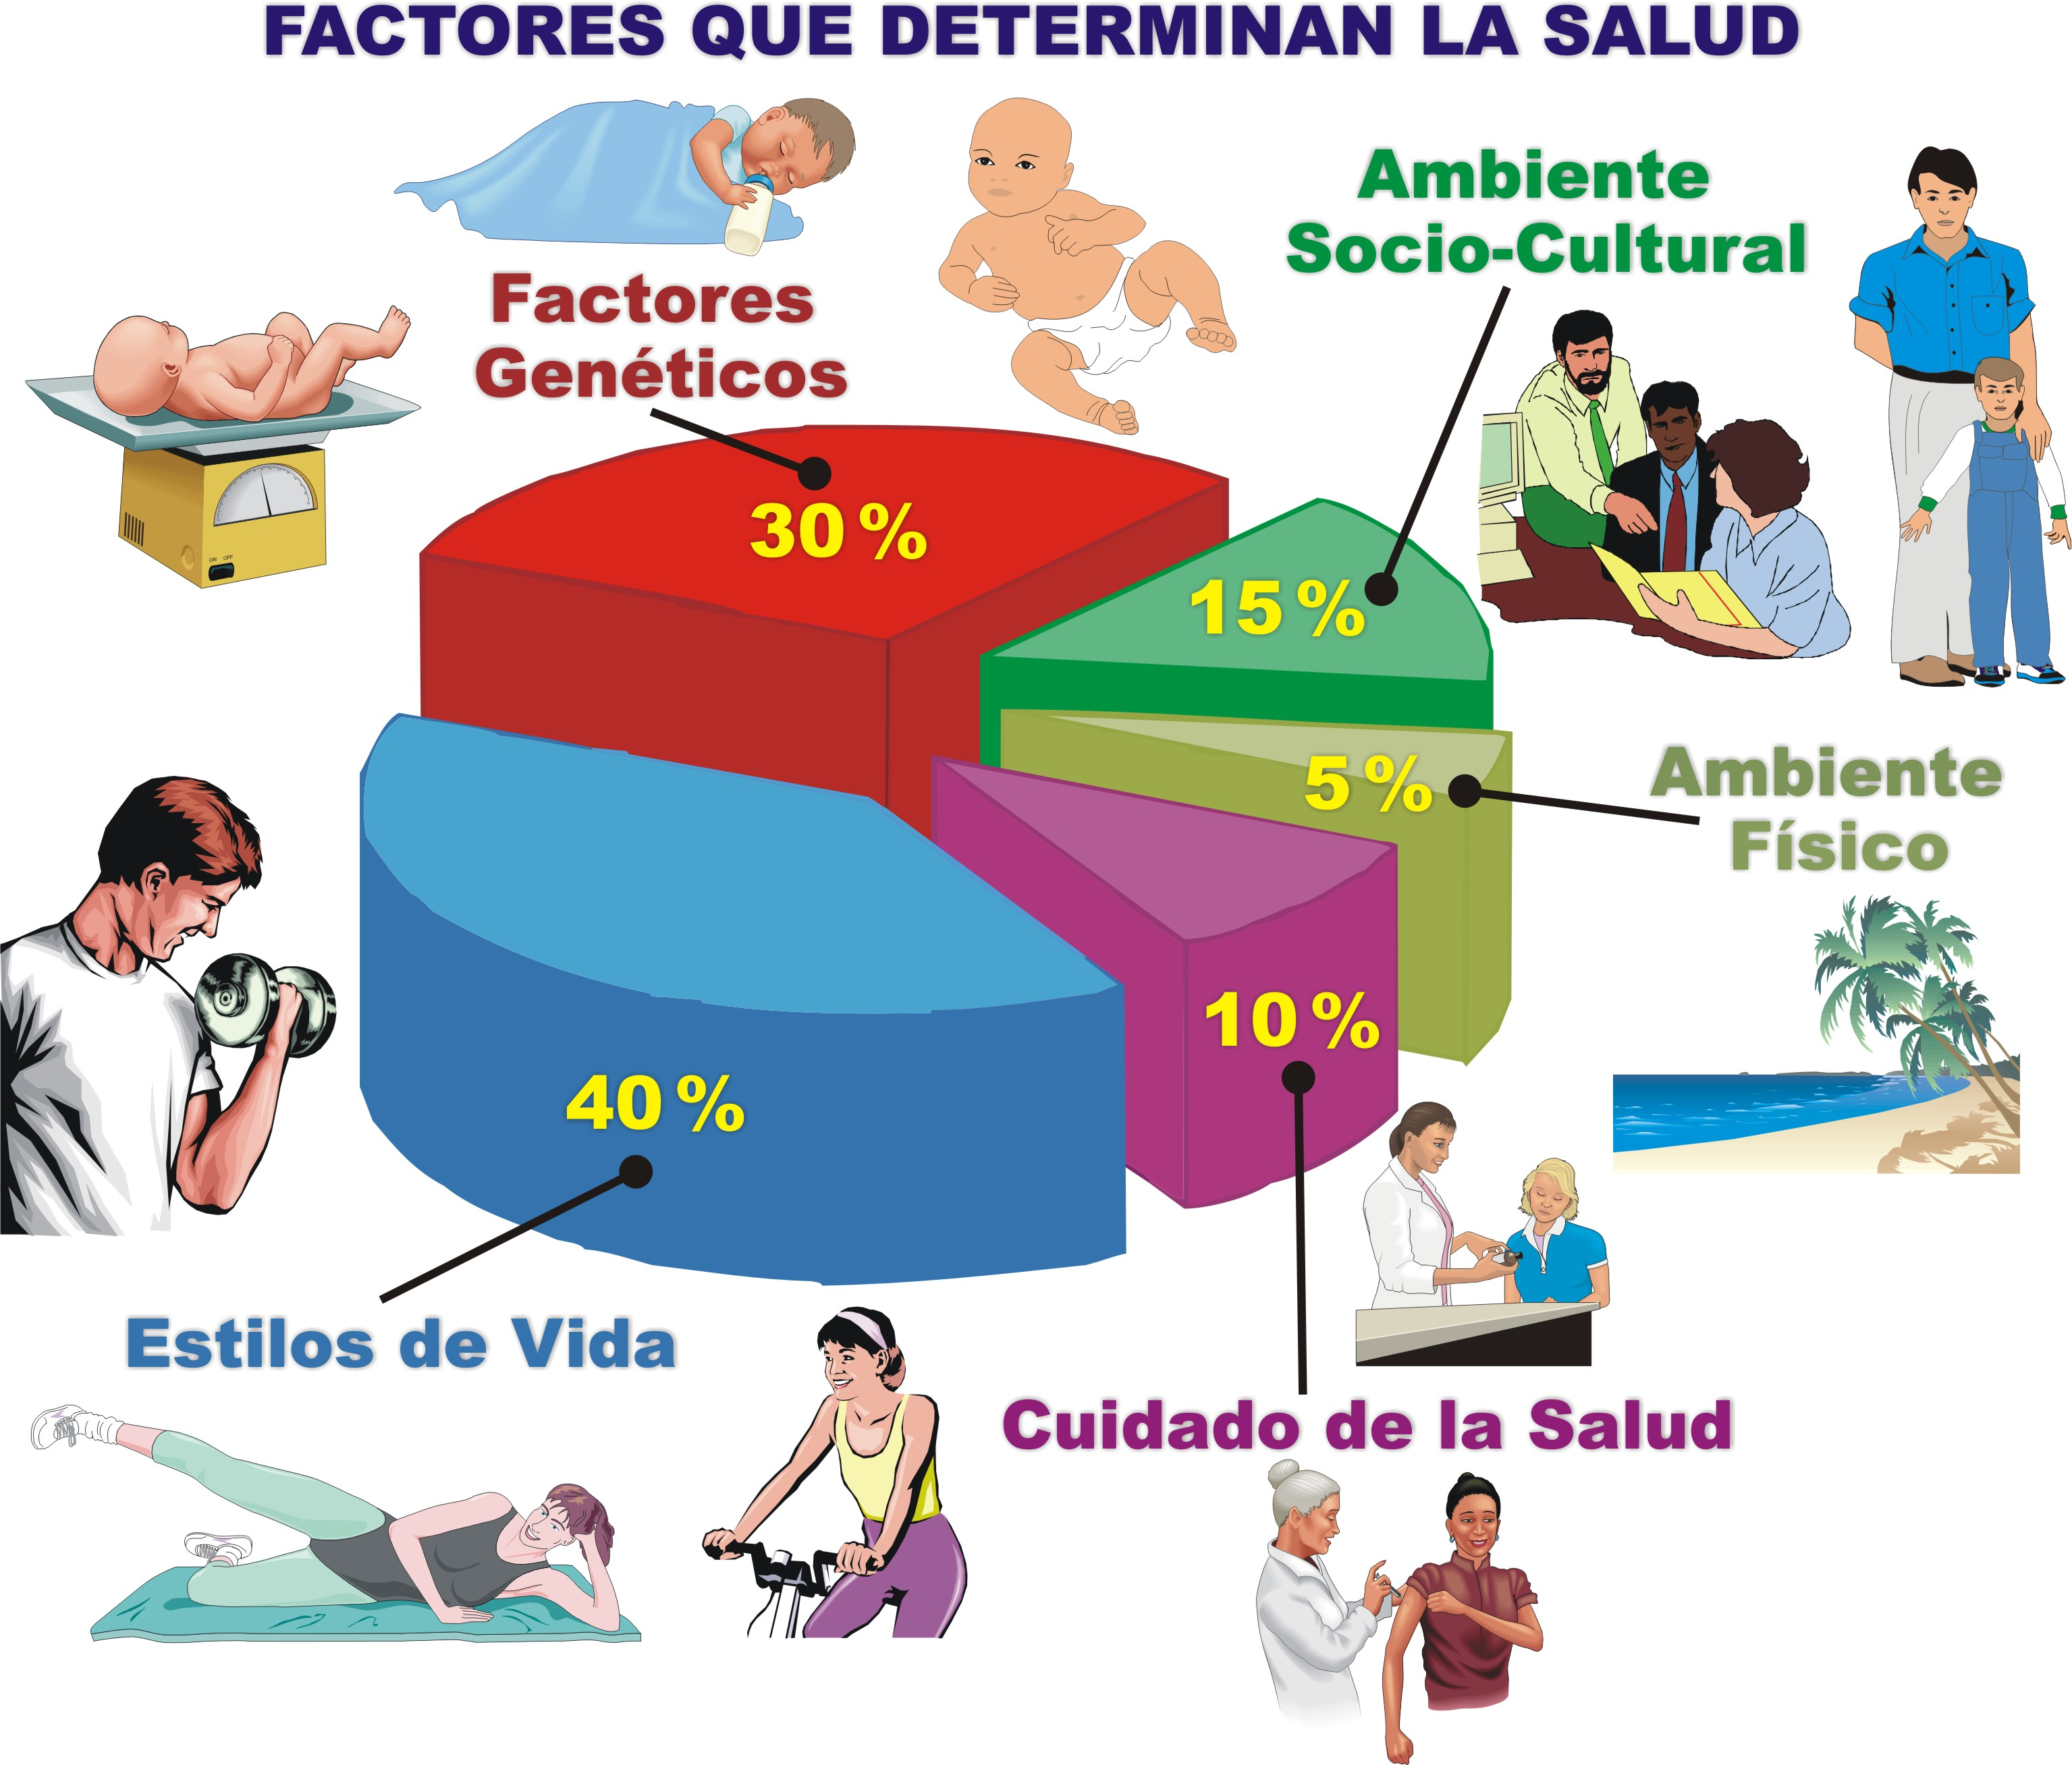
NOTA. Datos de: "The Case for more Active Policy Attention to Health Promotion," por M. J. McGinnis, P. Williams-Russo, y J. R. Knickman, 2002, Health Affairs, 21(2), p. 83. Copyright 2003 por Project HOPE - The People-to-People Health Foundation. doi:10.1377/hlthaff.21.2.78. Recuperado de http://content.healthaffairs.org/content/21/2/78.full.html
Notes:
23

Slide 24
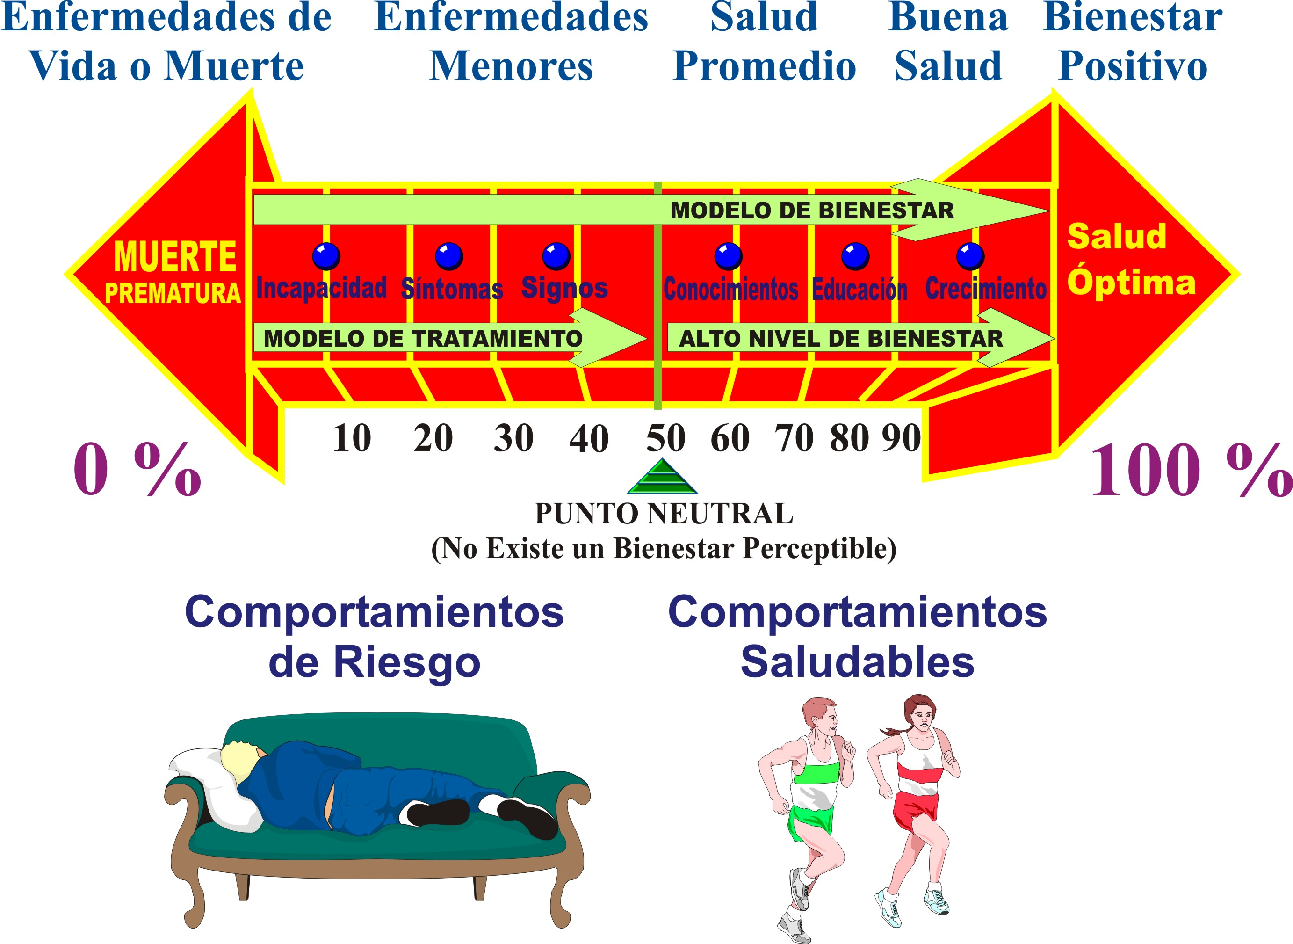
LA ESCALA CONTINUA: ENFERMEDAD A BIENESTAR
Notes:
24

Slide 25
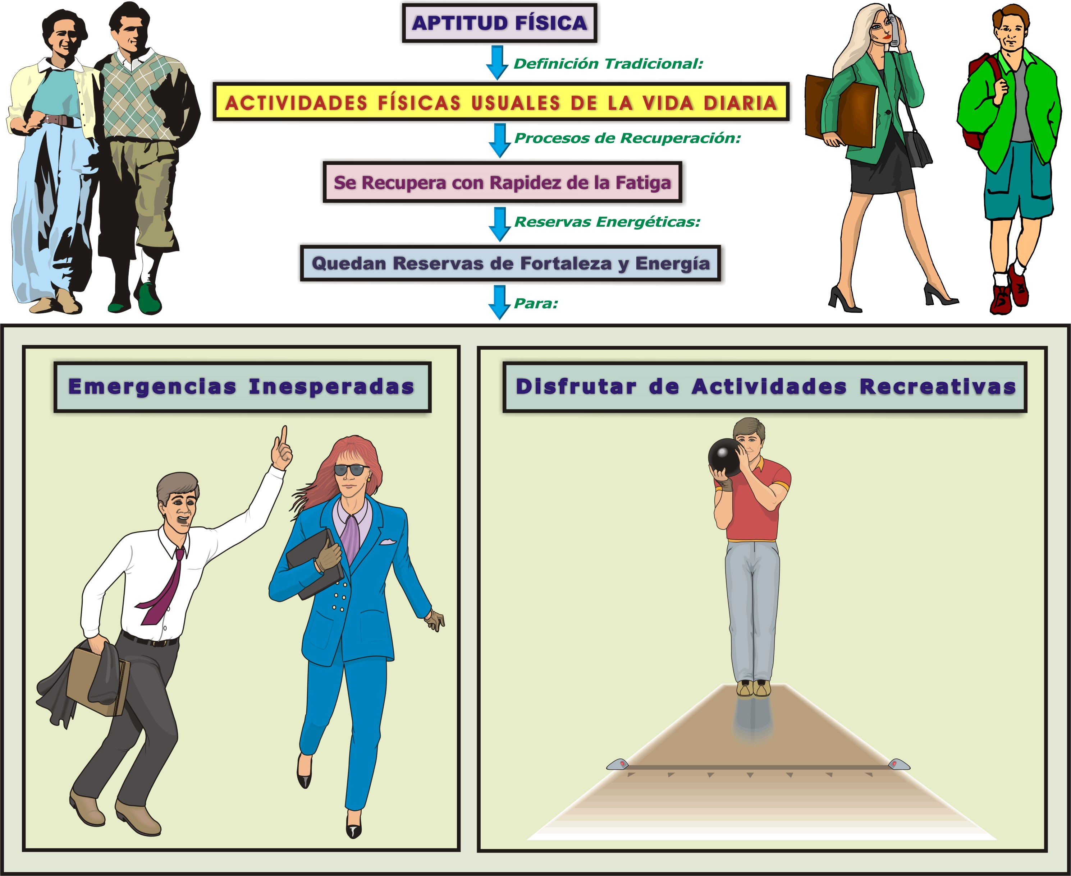
Notes:
25

Slide 26
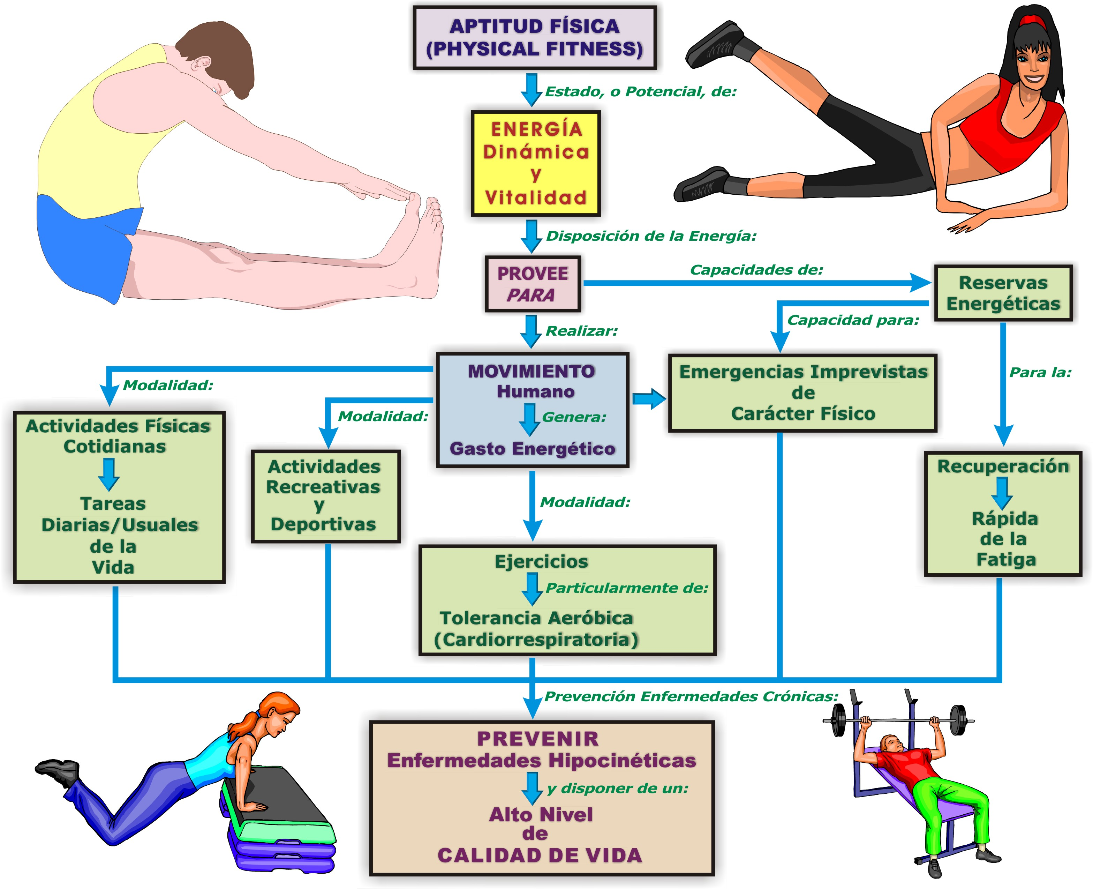
Notes:
26

Slide 27
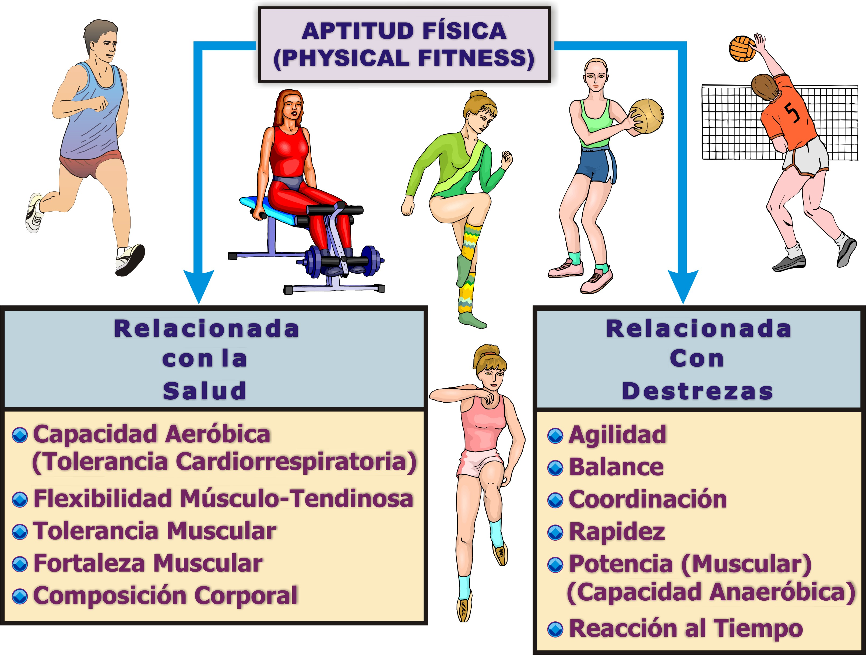
NOTA. Adaptado de: "Physical Activity, Exercise, and Physical Fitness: Definitions and Distinctions for Health-Related Research", por: C. J. Caspersen, K. E. Powell, y G. M. Christensen, 1985, Public Health Reports, 100(2), p. 128. Recuperado de http://pubmedcentralcanada.ca/pmcc/articles/PMC1424733/pdf/pubhealthrep00100-0016.pdf
Notes:
27

Slide 28
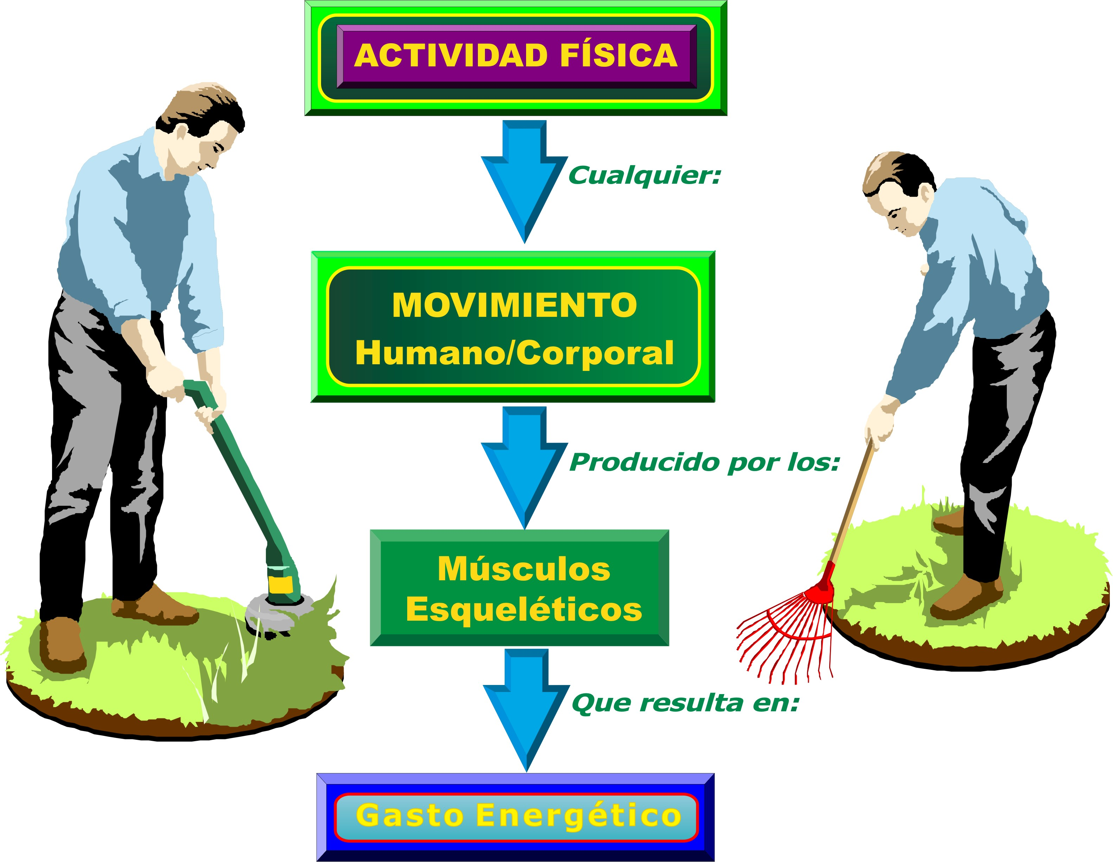
NOTA. Adaptado de: "Physical Activity, Exercise, and Physical Fitness: Definitions and Distinctions for Health-Related Research", por: C. J. Caspersen, K. E. Powell, y G. M. Christensen, 1985, Public Health Reports, 100(2), p. 126. Recuperado de http://pubmedcentralcanada.ca/pmcc/articles/PMC1424733/pdf/pubhealthrep00100-0016.pdf
Notes:
28

Slide 29
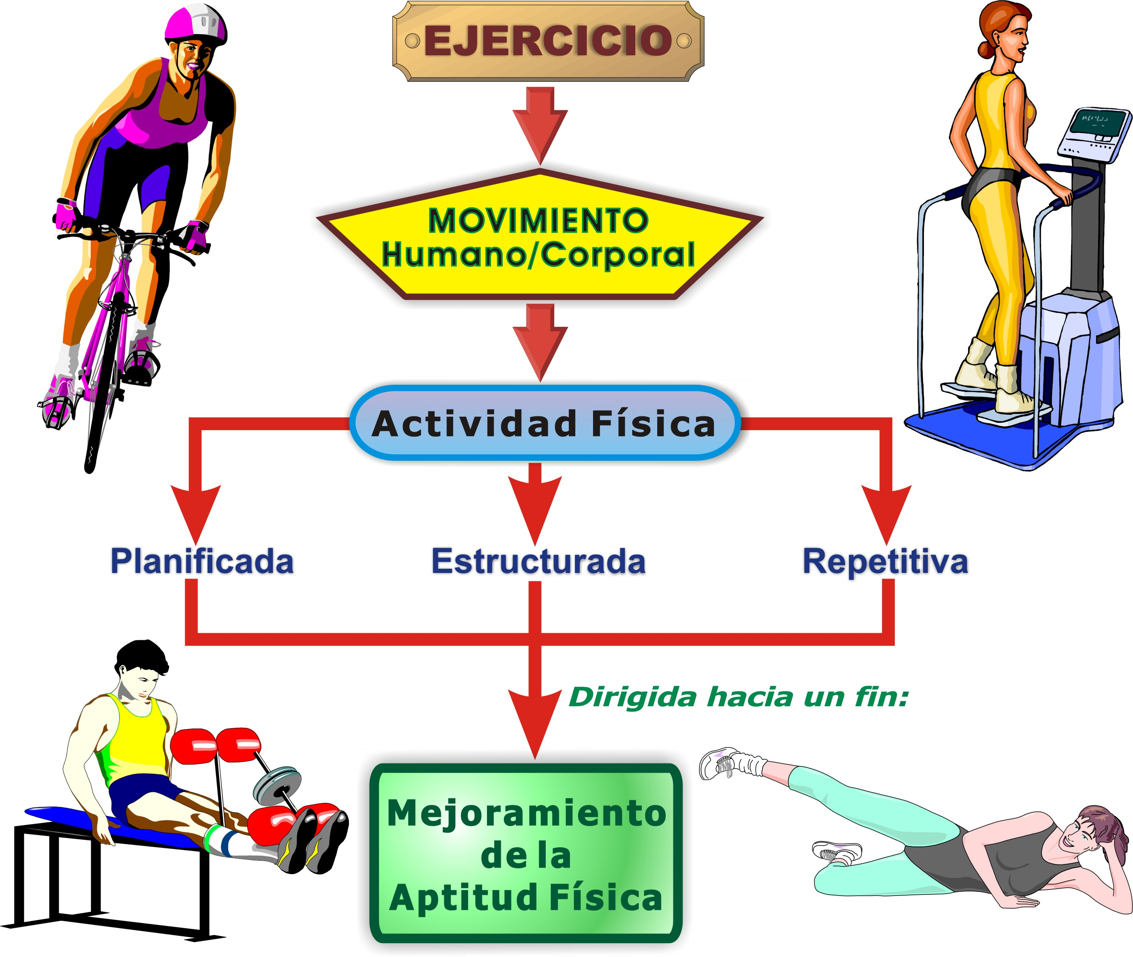
NOTA. Adaptado de: "Physical Activity, Exercise, and Physical Fitness: Definitions and Distinctions for Health-Related Research", por: C. J. Caspersen, K. E. Powell, y G. M. Christensen, 1985, Public Health Reports, 100(2), p. 128. Recuperado de http://pubmedcentralcanada.ca/pmcc/articles/PMC1424733/pdf/pubhealthrep00100-0016.pdf
Notes:
29

Slide 30
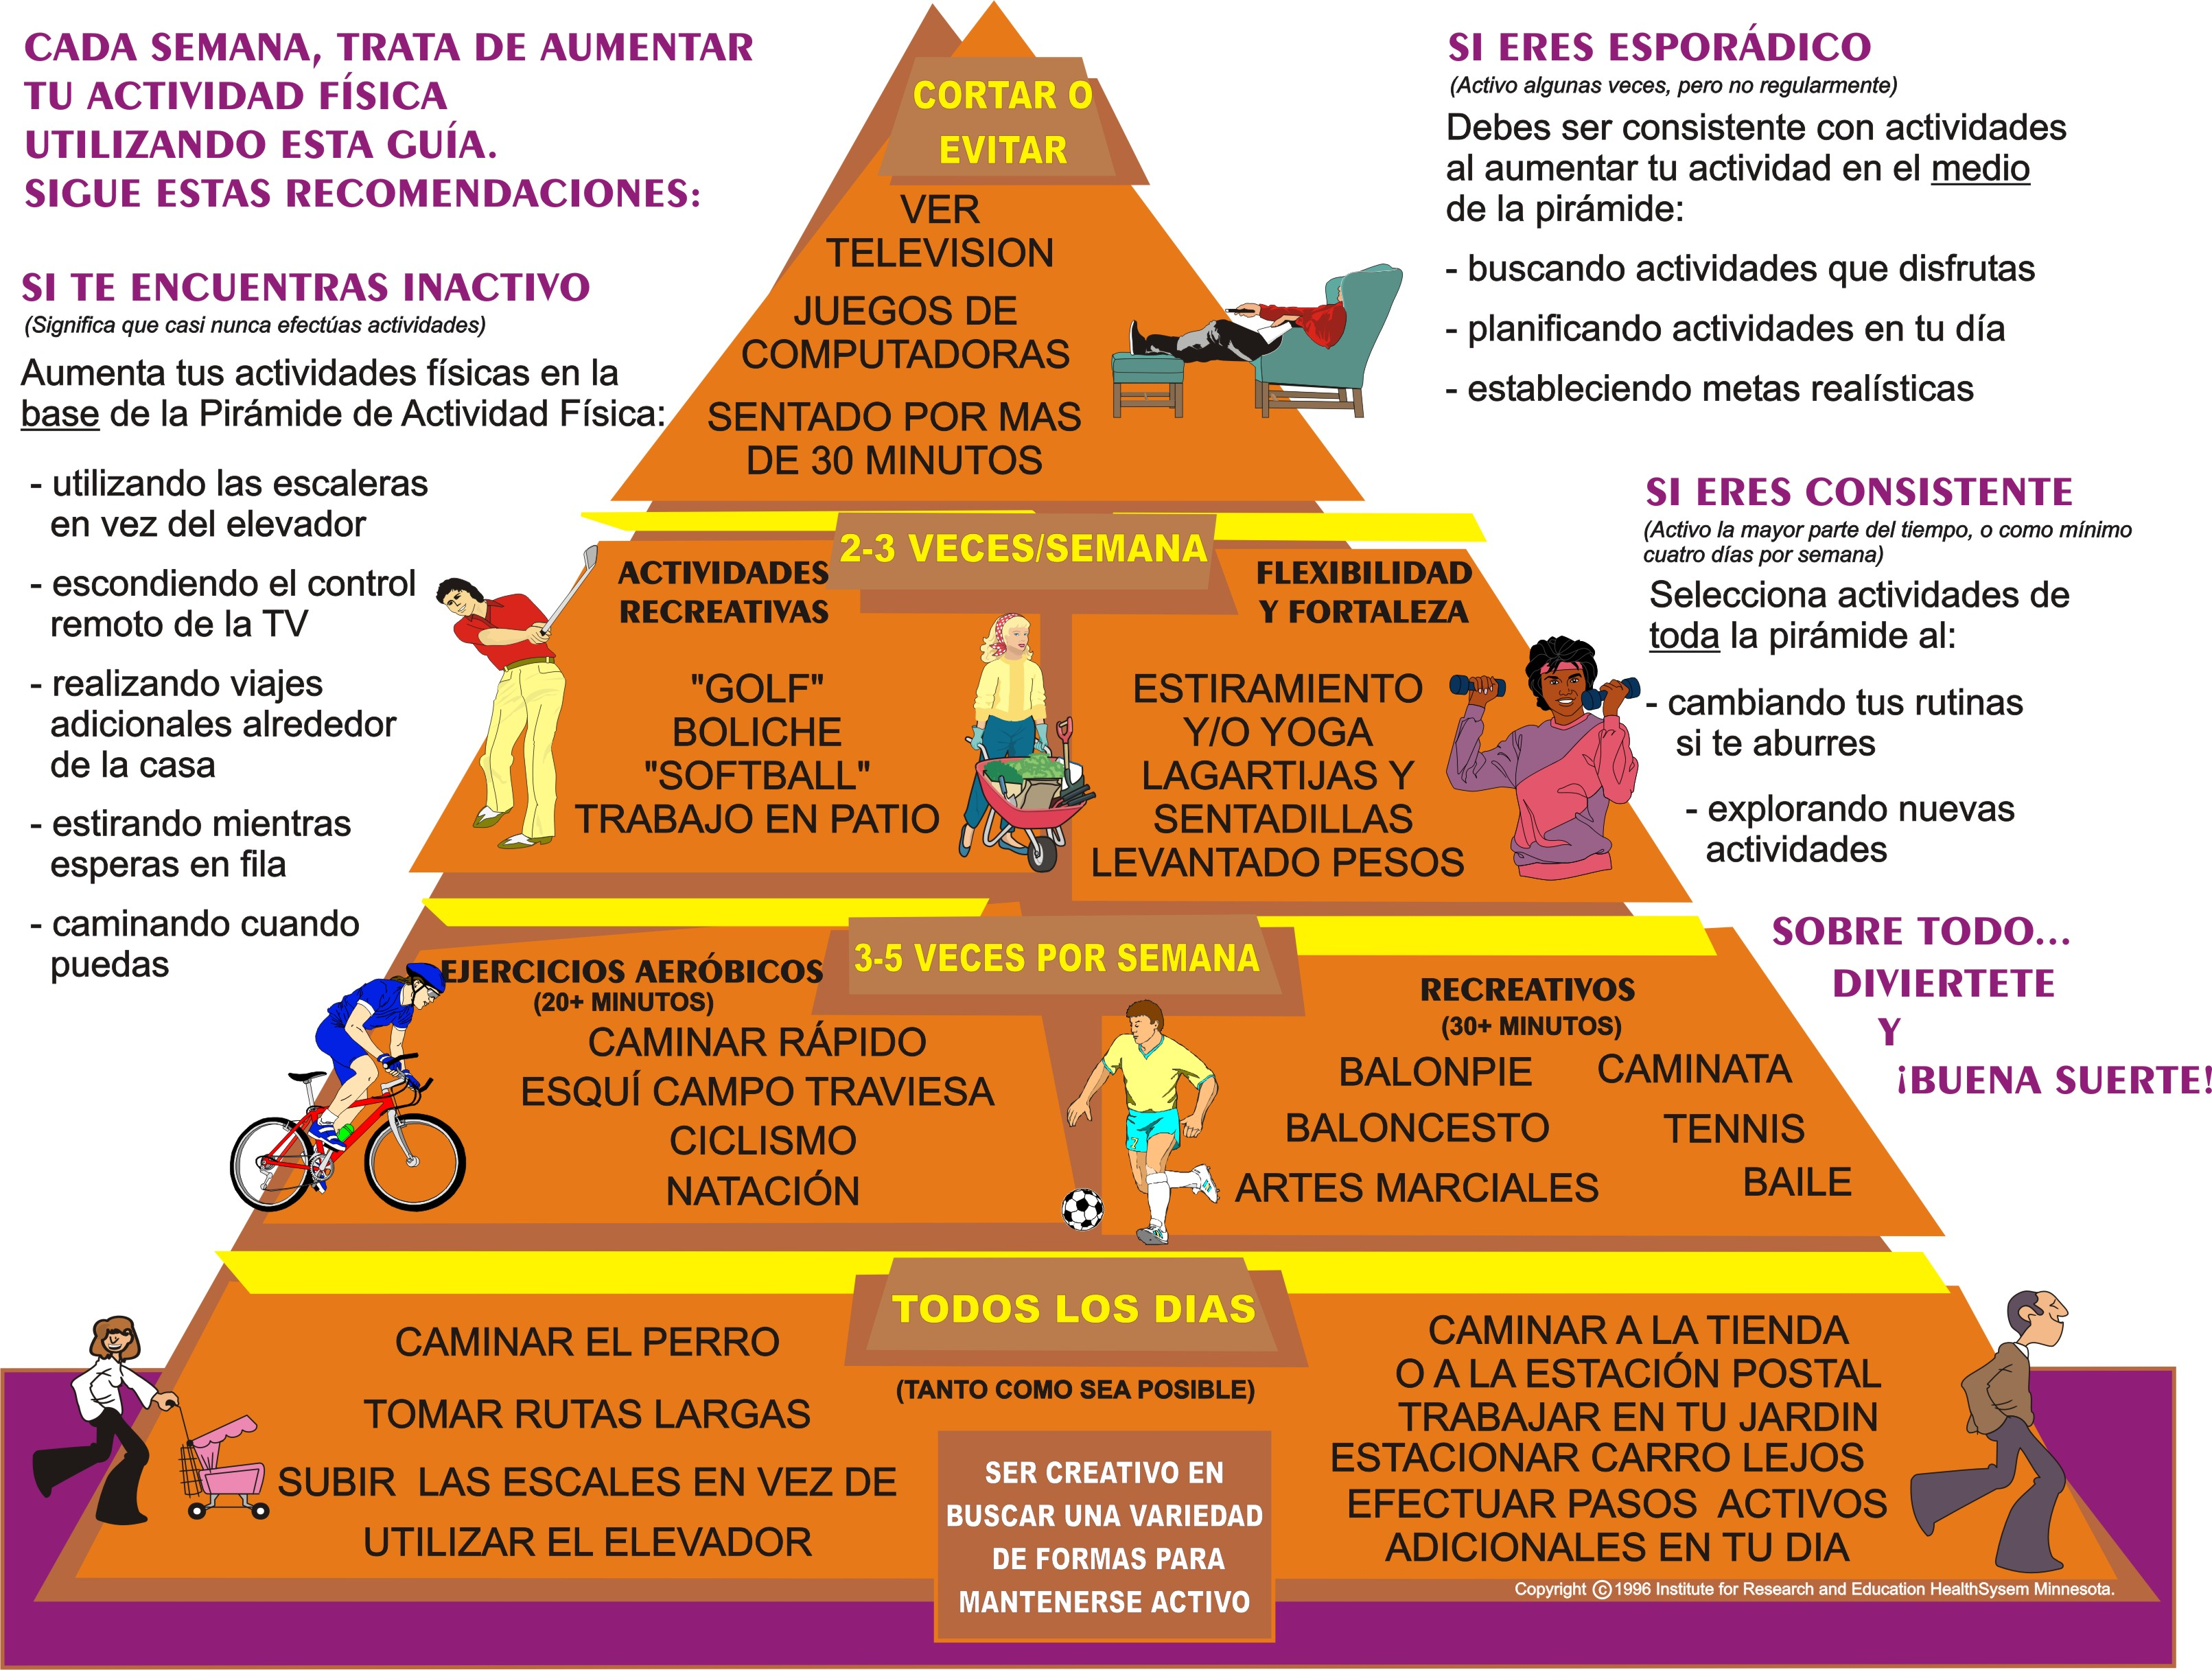
NOTA. Adaptado de: "The Activity Pyramid: A New Easy-to-Follow Physical Activity Guide to Help you get Fit & Stay Healthy", [Brochure]. Copyright 1996 por Institute for Research and Education HealthSystem Minnesota.
Notes:
30

Slide 31
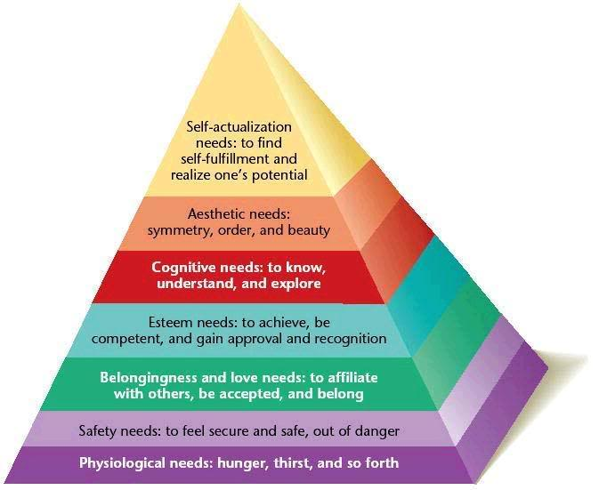
LA PIRÁMIDE DE NECESIDADES DE MASLOW
NOTA. Datos de: "Beyond Maslow’s Hierarchy of Needs," por K. Mcmahon, 2012,. Peak Oil Blues: EXPLORING EMOTIONAL REACTIONS TO A CHANGING WORLD. Recuperado de http://www.peakoilblues.org/blog/2011/03/02/beyond-maslows-hierarchy-of-needs/
Notes:
31

Slide 32
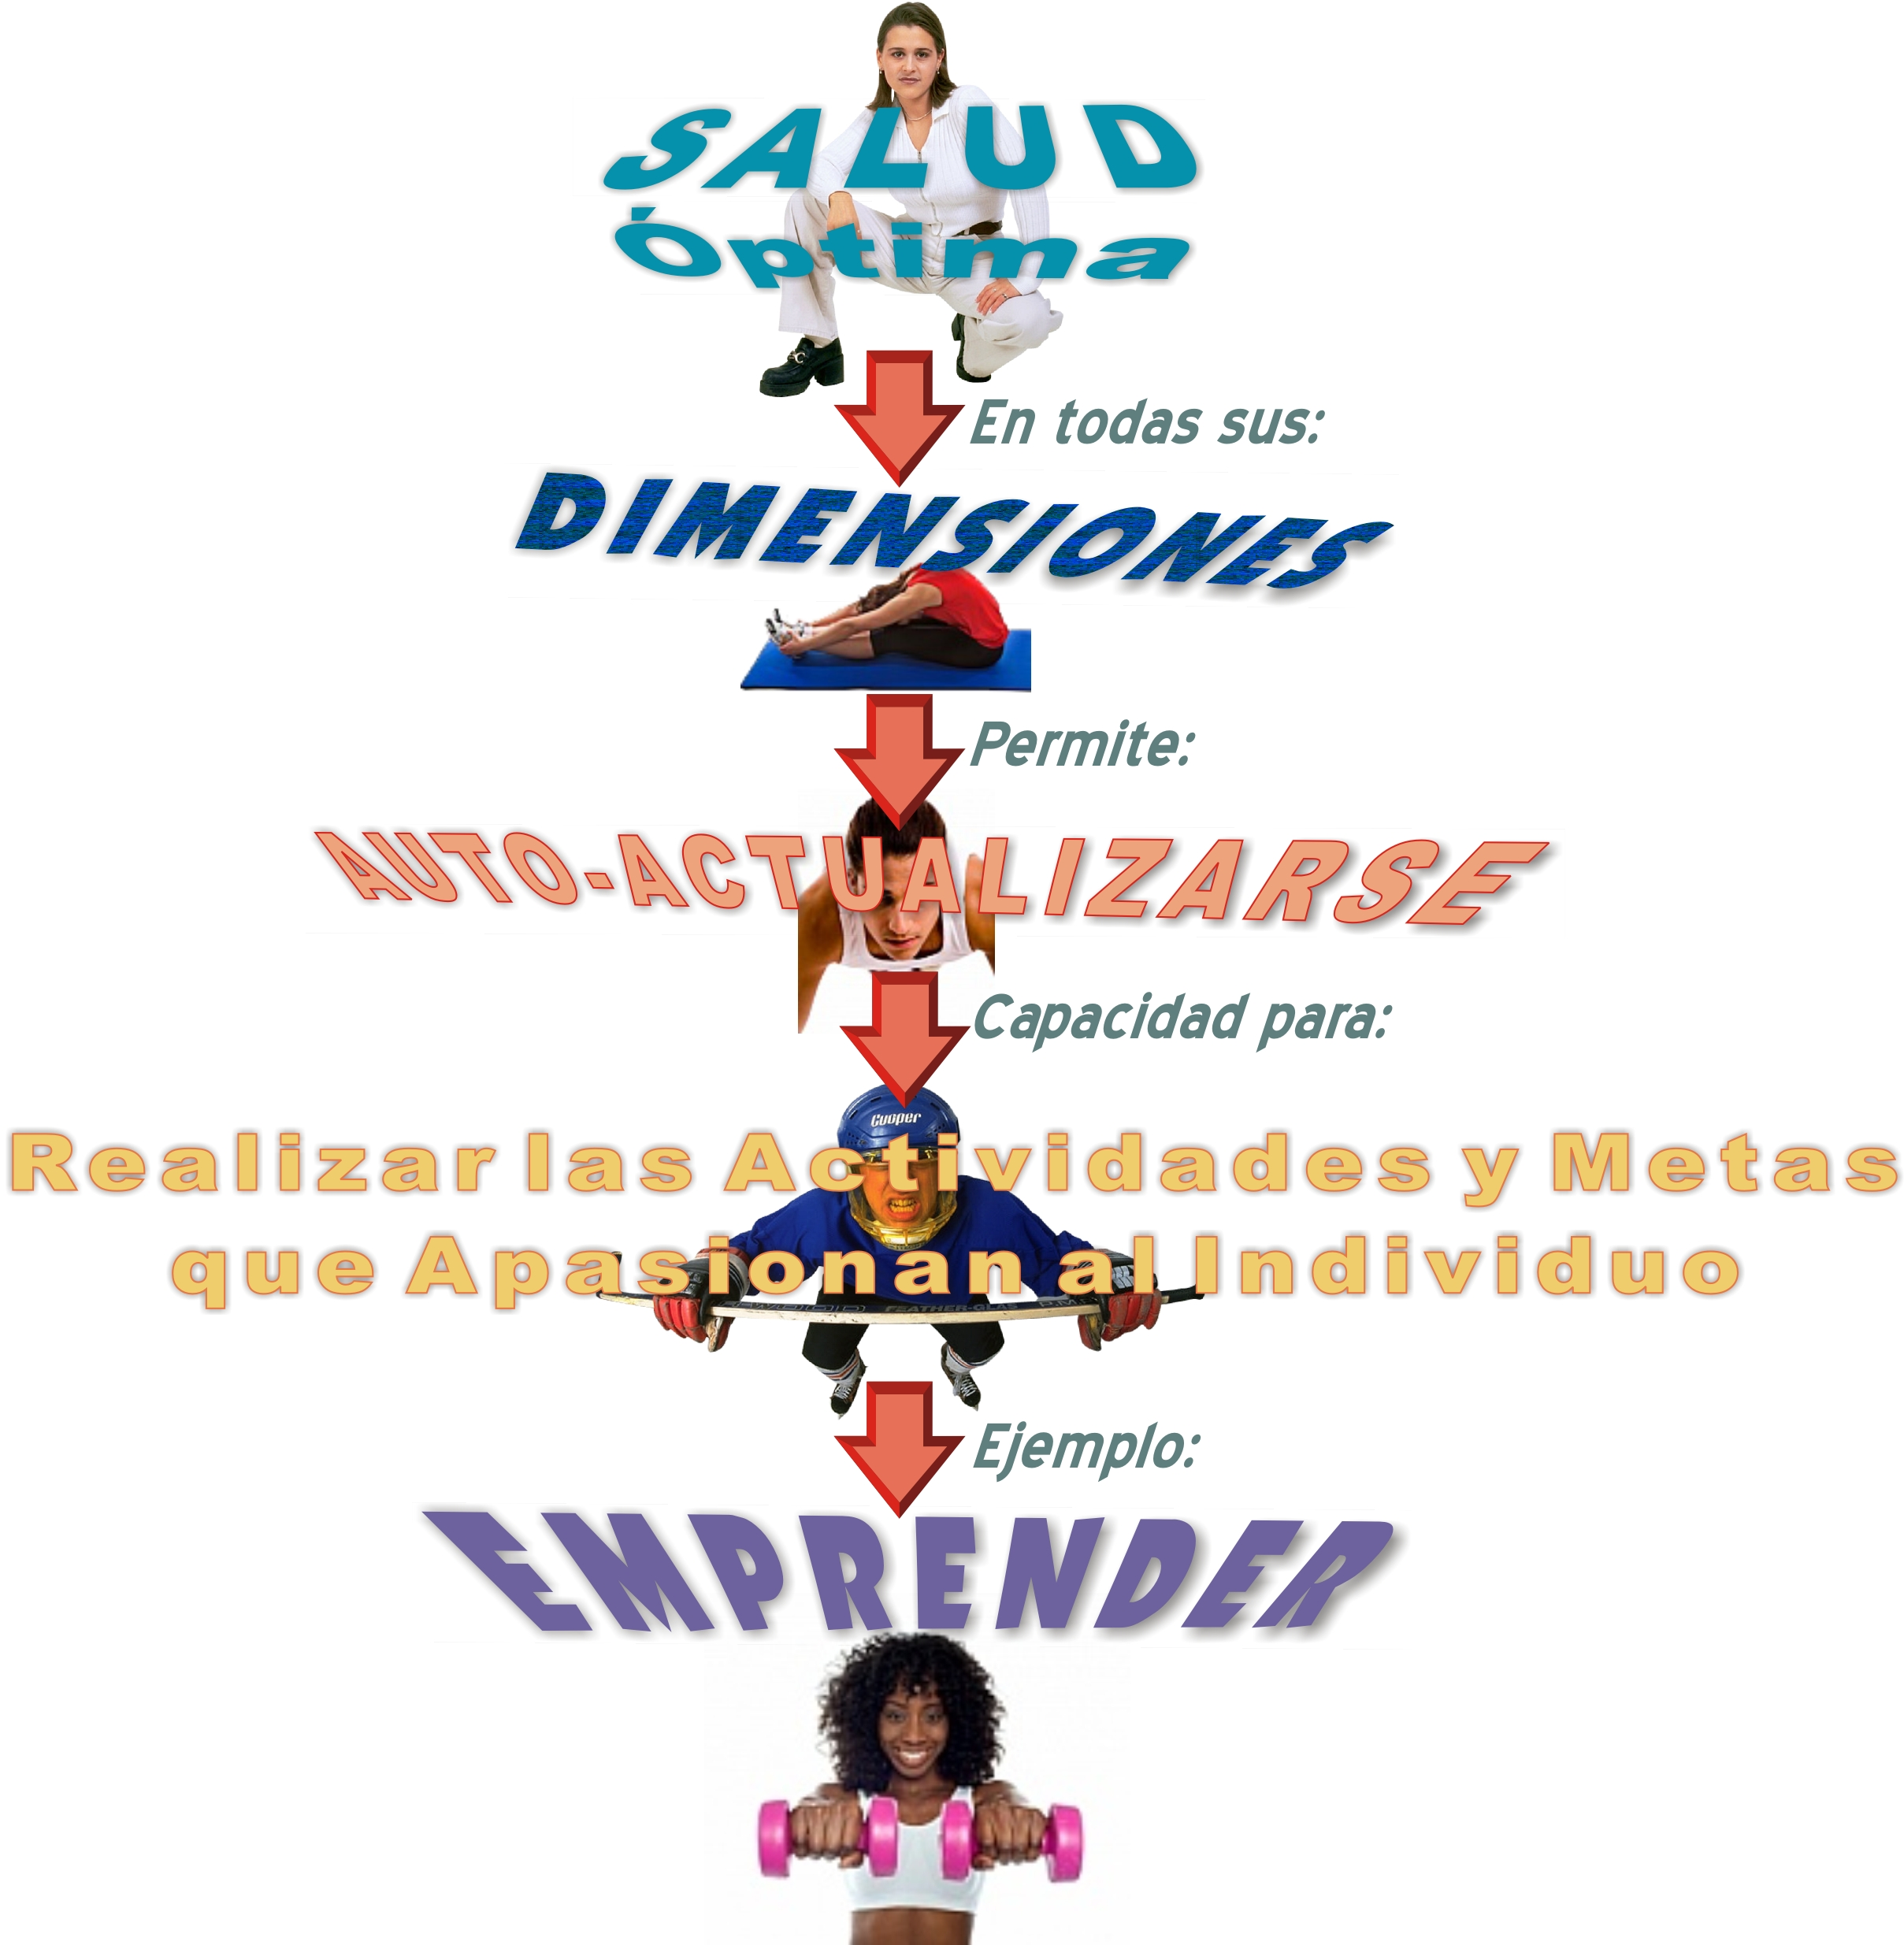
Notes:
32

Slide 33
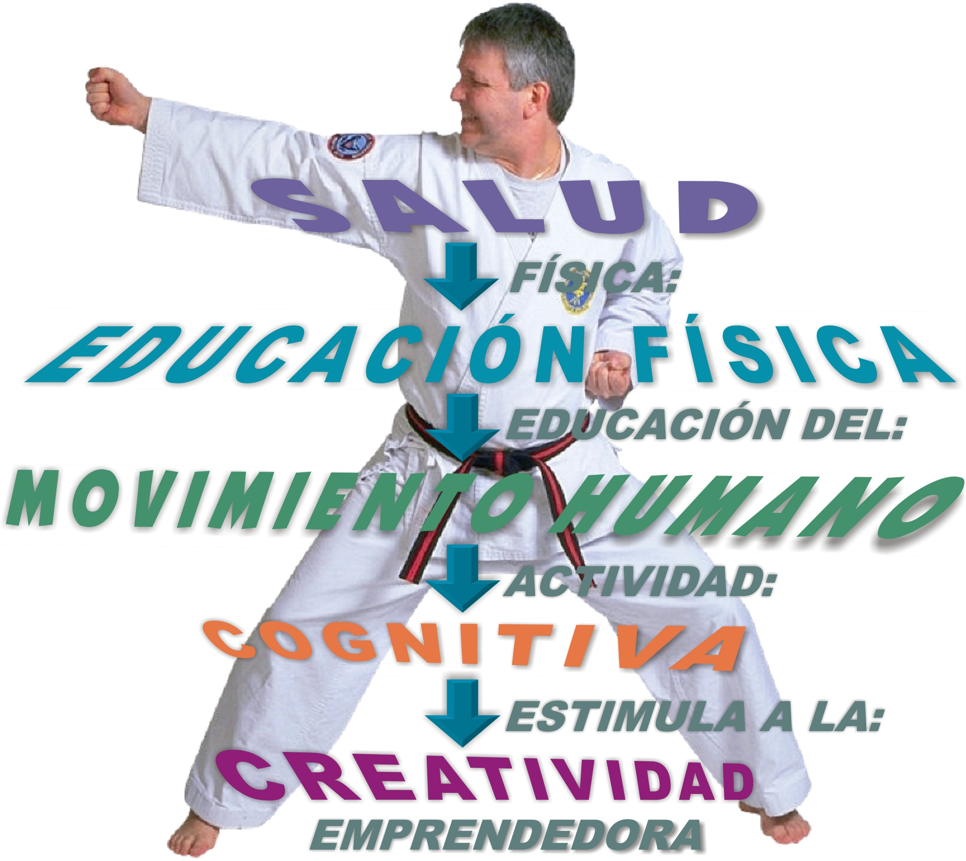
Notes:
33

Slide 34

Bailey, R. (2006). Physical Education and Sport in Schools: A Review of Benefits and Outcomes. Journal of School Health, 76(8), 397-401. doi:10.1111/j.1746-1561.2006.00132.x. Recuperado de la base de datos de EBSCOhost (Academic Search Premier).
Notes:
34

Slide 35

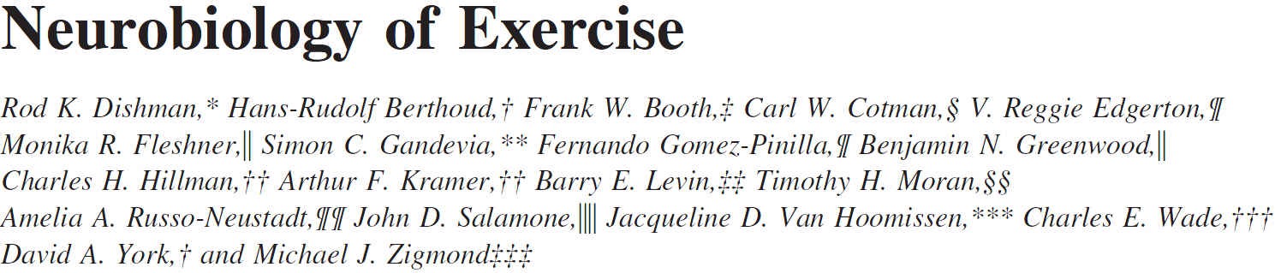
Dishman, R. K., Berthoud, H. R., Booth, F. W., Cotman, C. W., Edgerton, V. R., Fleshner, M. R., Gandevia, S. C., Gomez-Pinilla, F., Greenwood, B. N., Hillman, C. H., Kramer, A. F., Levin, B. E., Moran, T. H., Russo-Neustadt, A. A., Salamone, J. D., Van Hoomissen, J. D., Wade, C. E., York, D. A., & Zigmond, M. J. (2006). Neurobiology of exercise. Obesity, 14(3), 345-356. Recuperado de http://onlinelibrary.wiley.com/doi/10.1038/oby.2006.46/pdf
Notes:
35

Slide 36

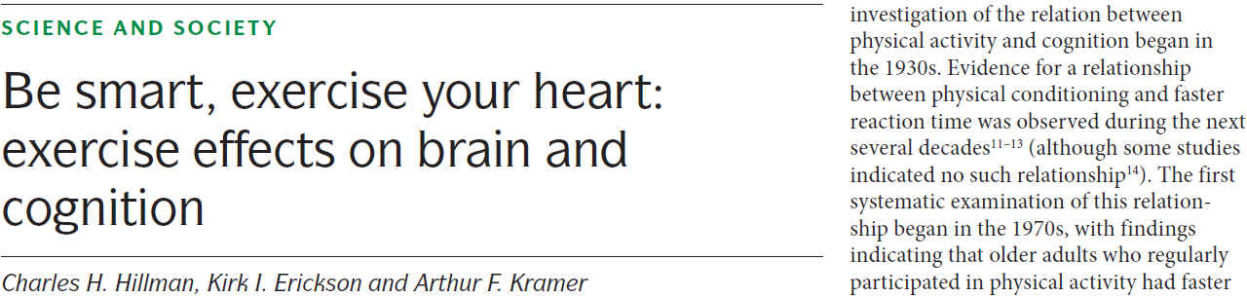
Hillman, C. H., Erickson, K. I., & Kramer, A. F. (2008). Be smart, exercise your heart: exercise effects on brain and cognition. Nature Reviews. Neuroscience, 9(1), 58-65. Recuperado de http://dericbownds.net/uploaded_images/exercise_hillman.pdf
Notes:
36

Slide 37
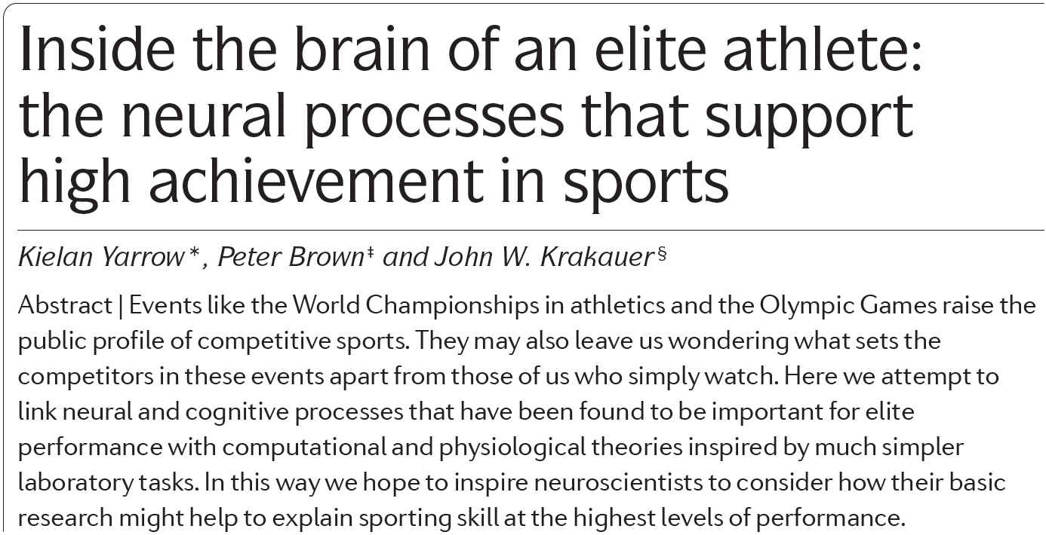
Yarrow, K., Brown, P., & Krakauer, J. W. (2009). Inside the brain of an elite athlete: the neural processes that support high achievement in sports. Nature Reviews. Neuroscience, 10(8), 585-596. doi:10.1038/nrn2672. Recuperado de la base de datos de EBSCOhost ( Academic Search Premier.)
Notes:
37

Slide 38
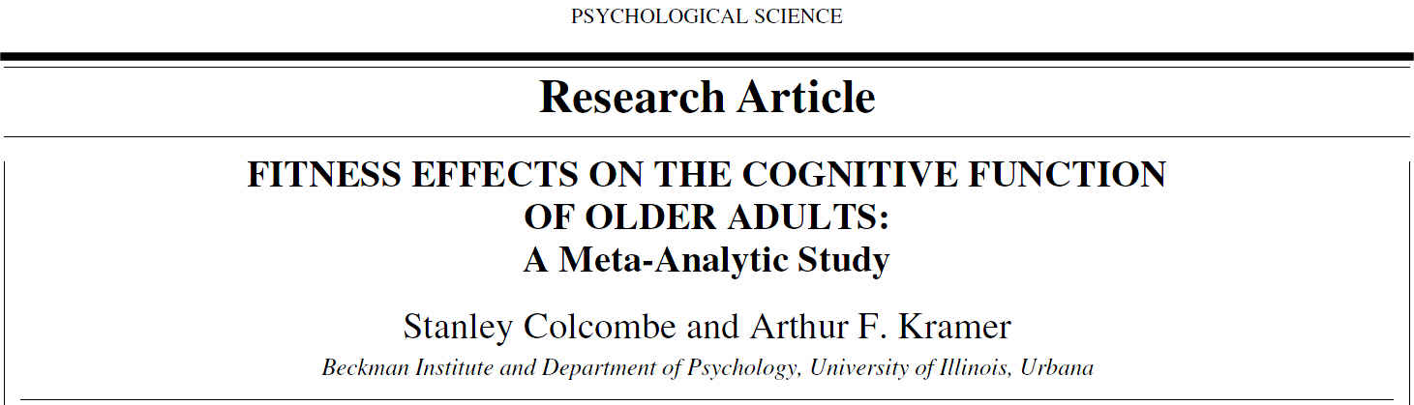
Colcombe, S., & Kramer, A. F. (2003). Fitness effects on the cognitive function of older adults: a meta-analytic study. Psychological Science, 14(2),125-130. Recuperado de http://www.psychologicalscience.org/pdf/ps/exercise_brain.pdf?q=research-article
Notes:
38

Slide 39
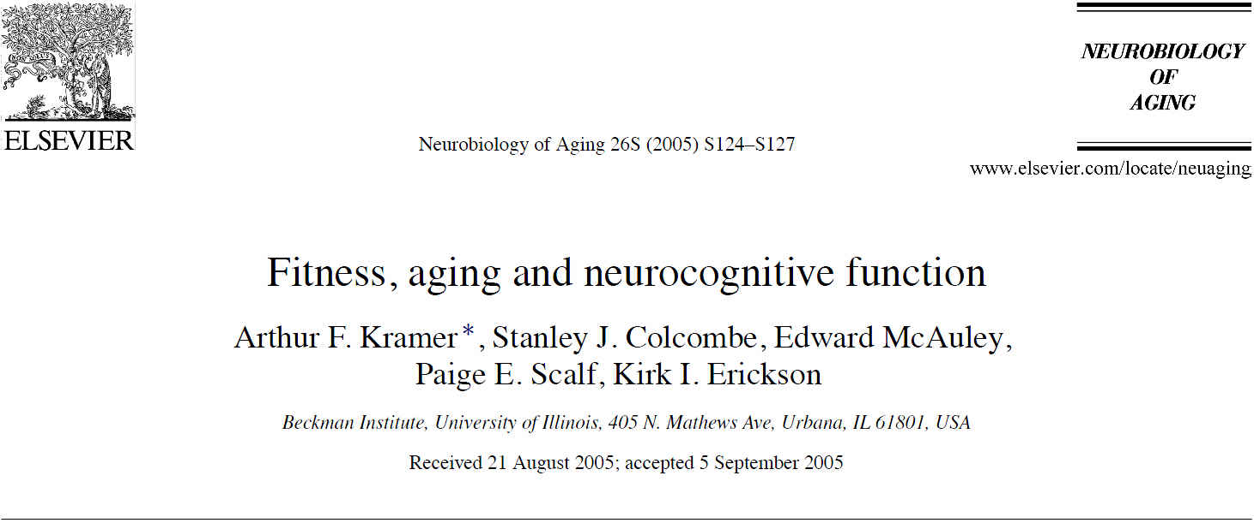
Kramer, A. F., Colcombe, S. J., McAuley, E., Scalf, P. E., Erickson, K. I. (2006). Fitness, aging and neurocognitive function. Neurobiology of Aging, 26(Suppl 1), 124-127. Recuperado de http://www.pitt.edu/~bachlab/LabSite/Publications.html/kramer2005.pdf
Notes:
39

Slide 40
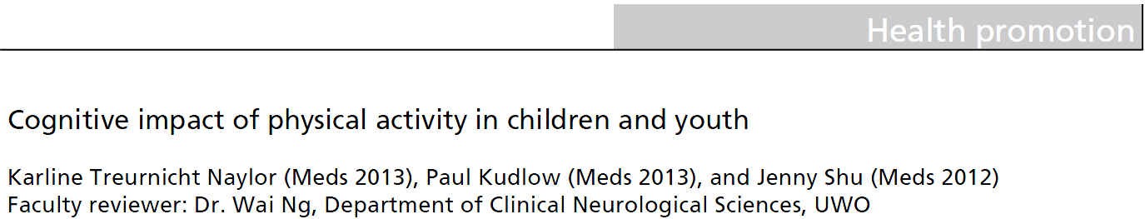
Naylor, K. T., Kudlow, P., & Shu, J. (2010). Cognitive impact of physical activity in children and youth. UWOMJ, 79(2), 13-15. Recuperado de http://www.uwomj.com/wp-content/uploads/2012/11/v79n2_5.pdf
Notes:
40

Slide 41
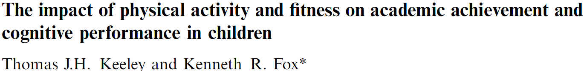
Keeley, T. J. H., & Fox, K. R. (2009). The impact of physical activity and ?tness on academic achievement and cognitive performance in children. International Review of Sport and Exercise Psychology, 2(2), 198-214. doi:10.1080/17509840903233822Recuperado de http://www.psahperd.org/Resources/Documents/Research%20Documents/Physical%20activity%20and%20fitness%20onacademics%20and%20cognitive%20understanding_Keely%20and%20Fox%202009.pdf
Notes:
41

Slide 42
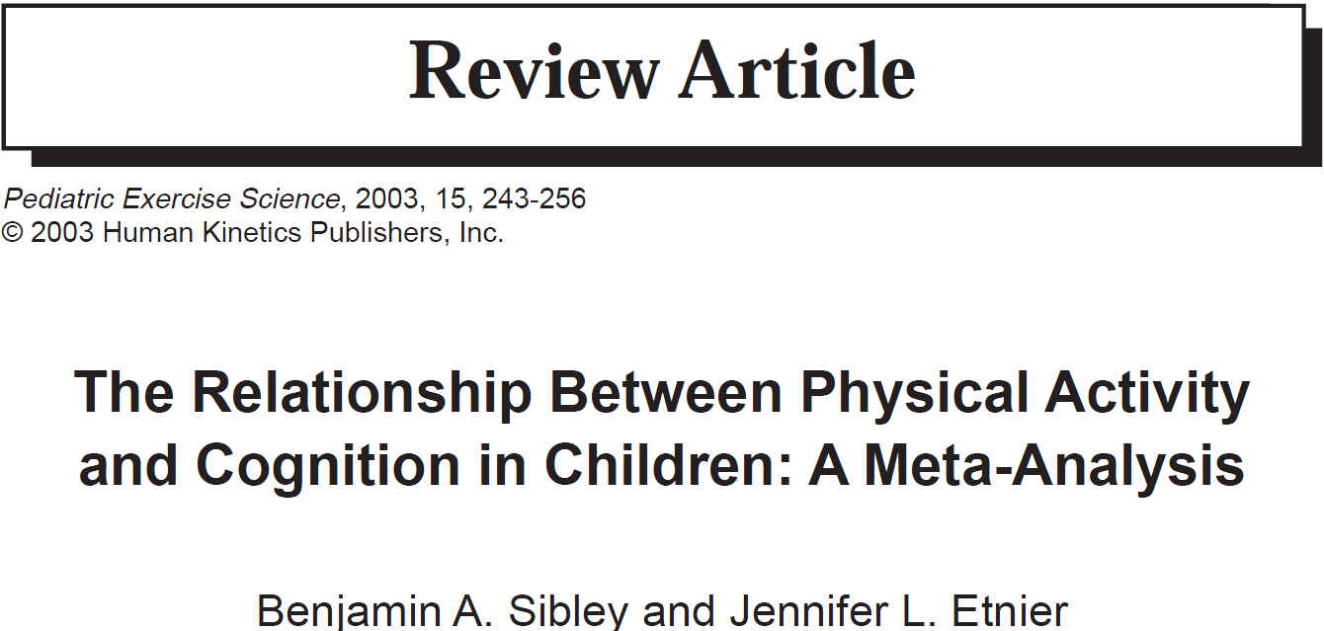
Sibley, B. A., & Etnier, J. (2003). The relationship between physical activity and cognition in children: A Meta-analysis. Pediatric Exercise Science, 15(3), 243-256. Recuperado de http://www.naspspa.org/AcuCustom/Sitename/Documents/DocumentItem/2196.pdf
Notes:
42

Slide 43
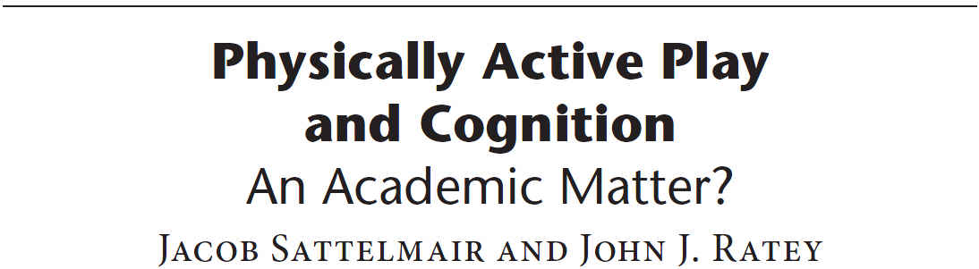
Sattelmair, J., & Ratey, J. J. (2009). Physically active play and cognition: An academic matter?. American Journal of Play, 1(3), 365-374. Recuperado de http://johnratey.typepad.com/SattelRatey.pdf
Notes:
43

Slide 44
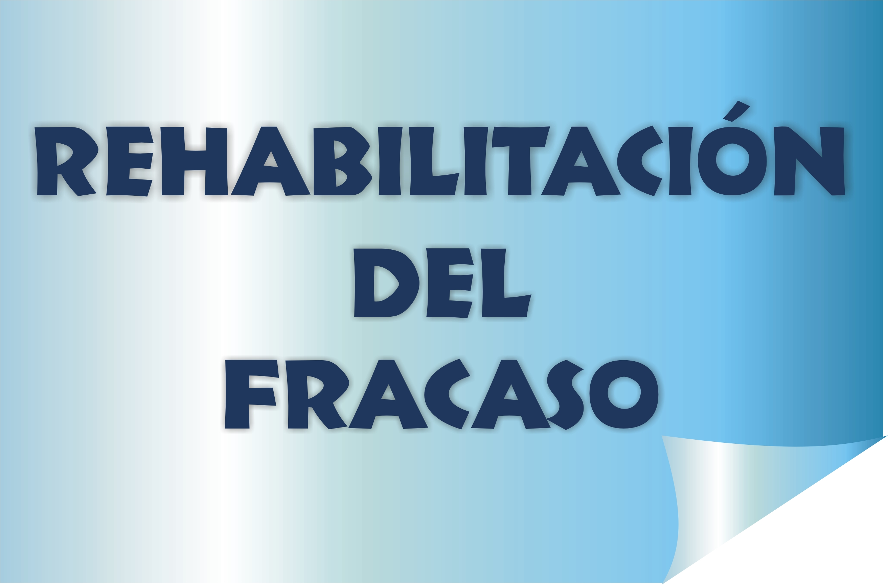
Notes:
44

Slide 45
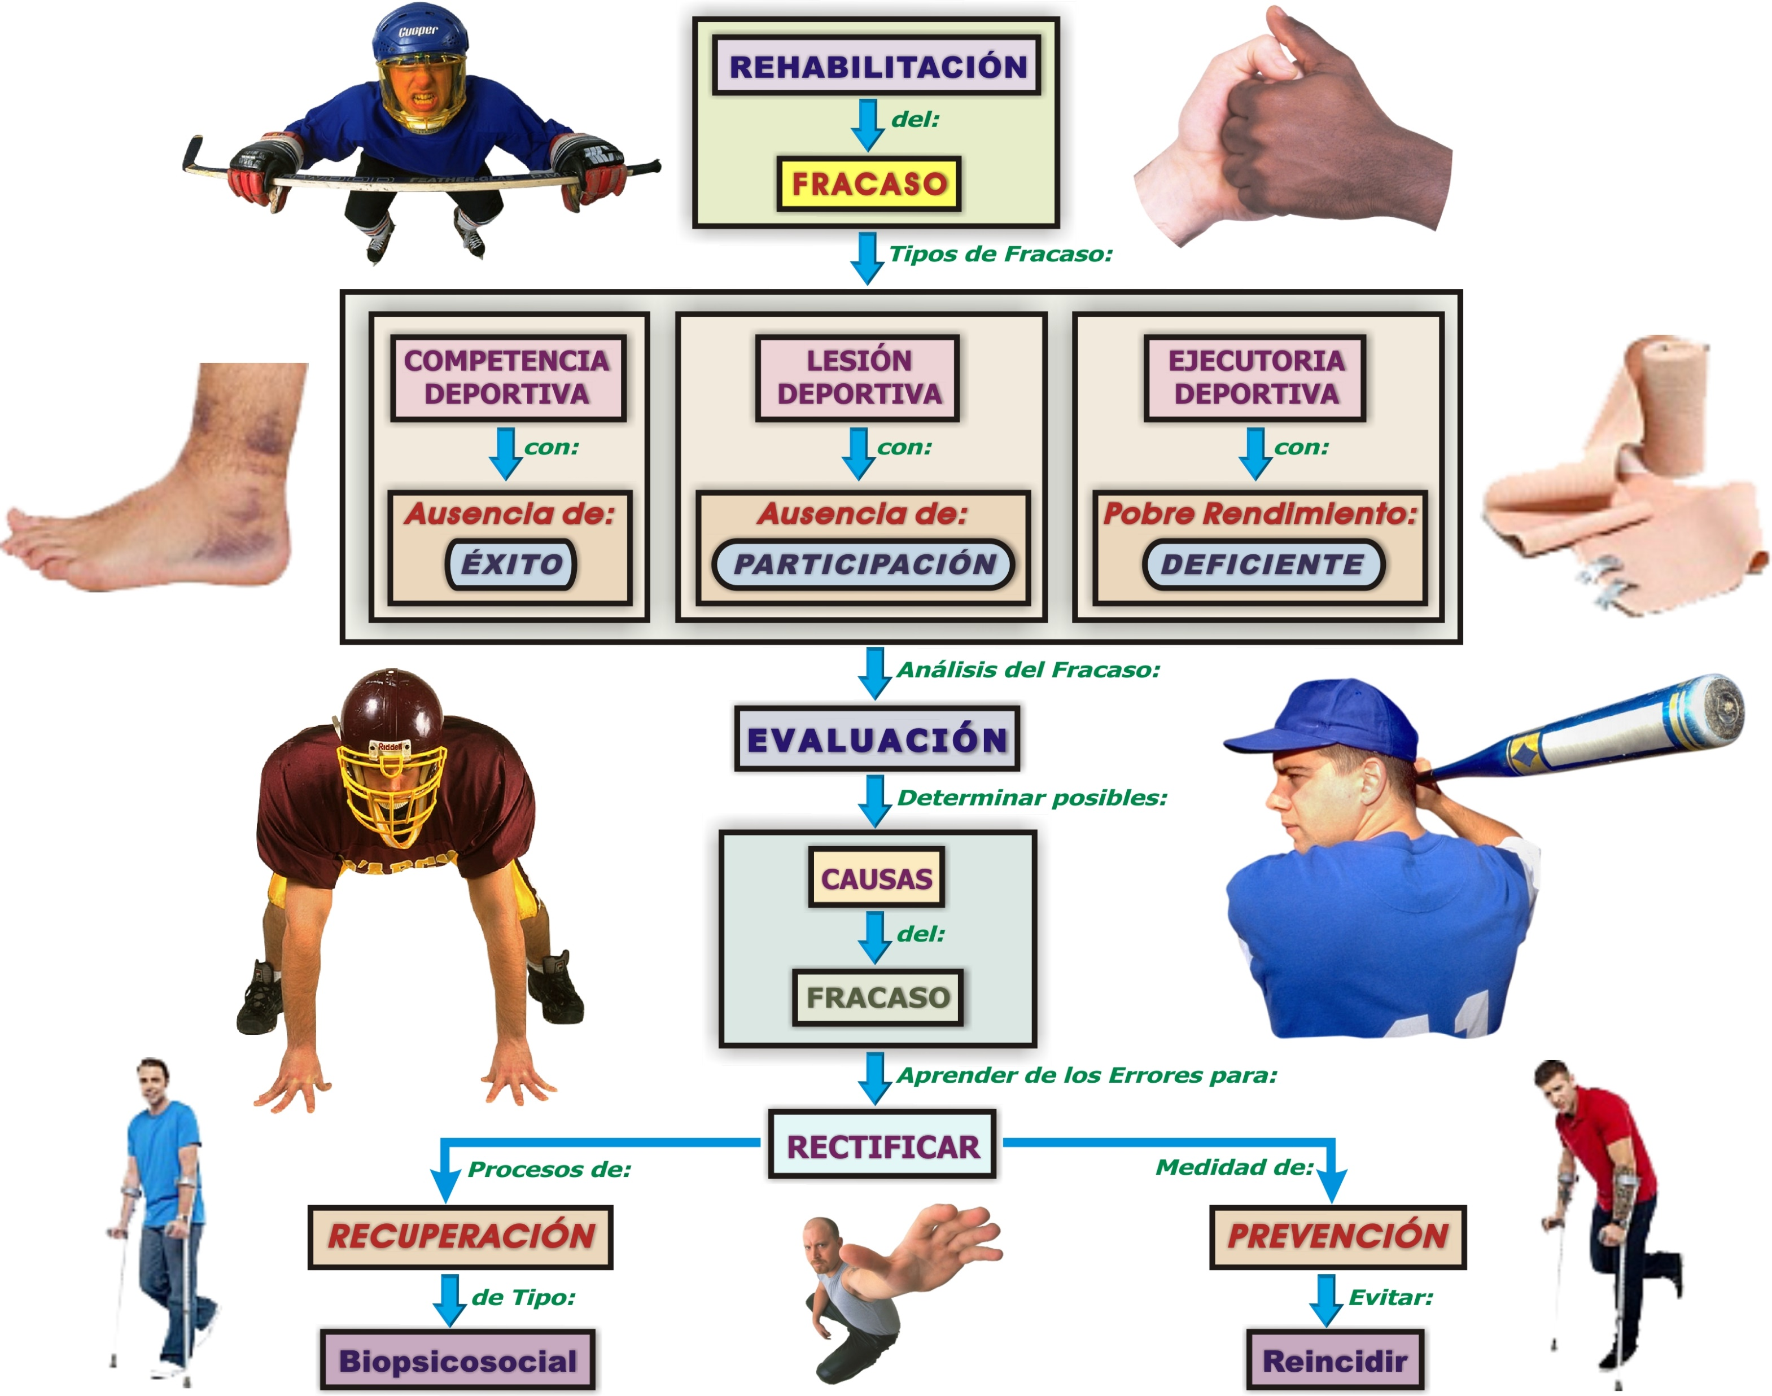
Notes:
45

Slide 46

Notes:
46

Slide 47

Notes:
47

Slide 48

Notes:
48

Slide 49

Notes:
49

Slide 50
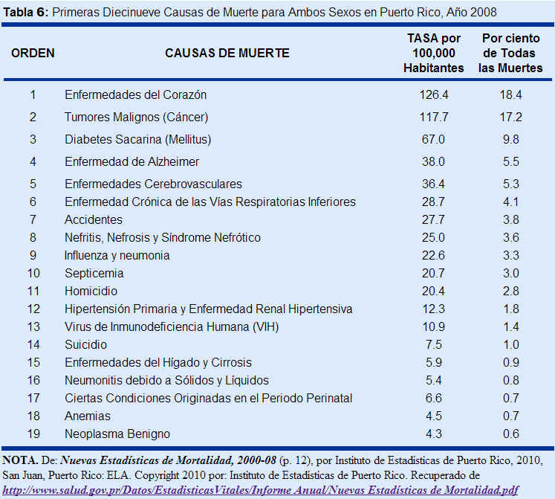
Notes:
50

Slide 51
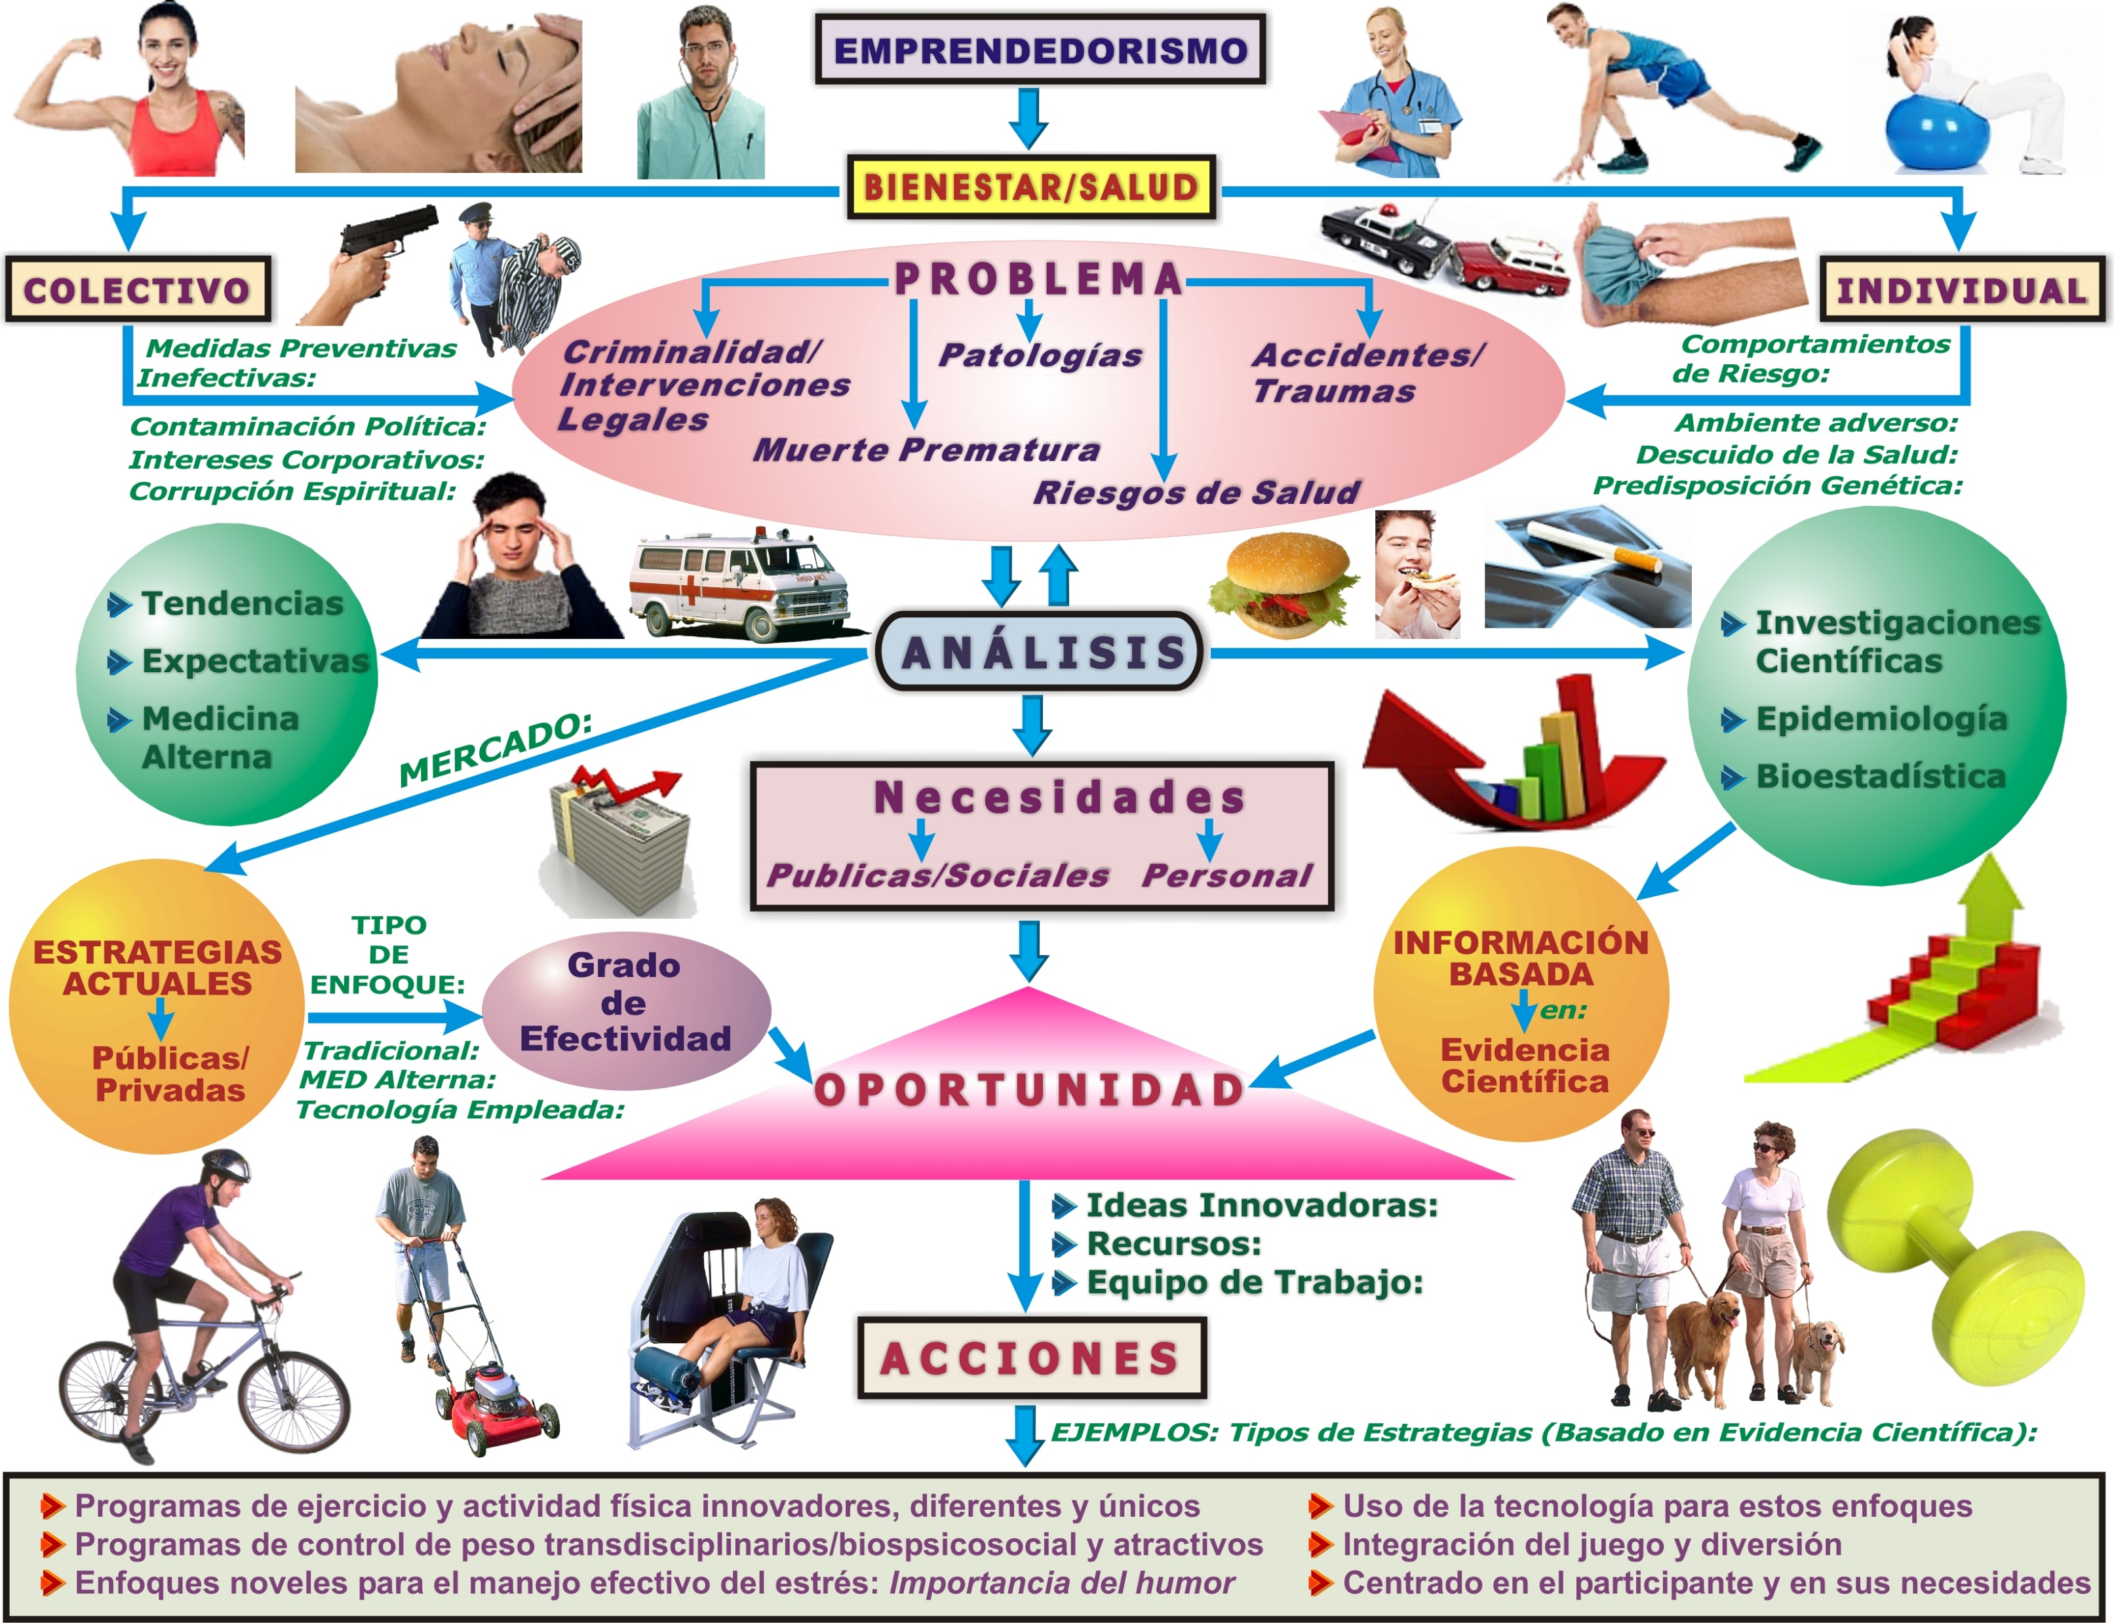
Notes:
51

Slide 52
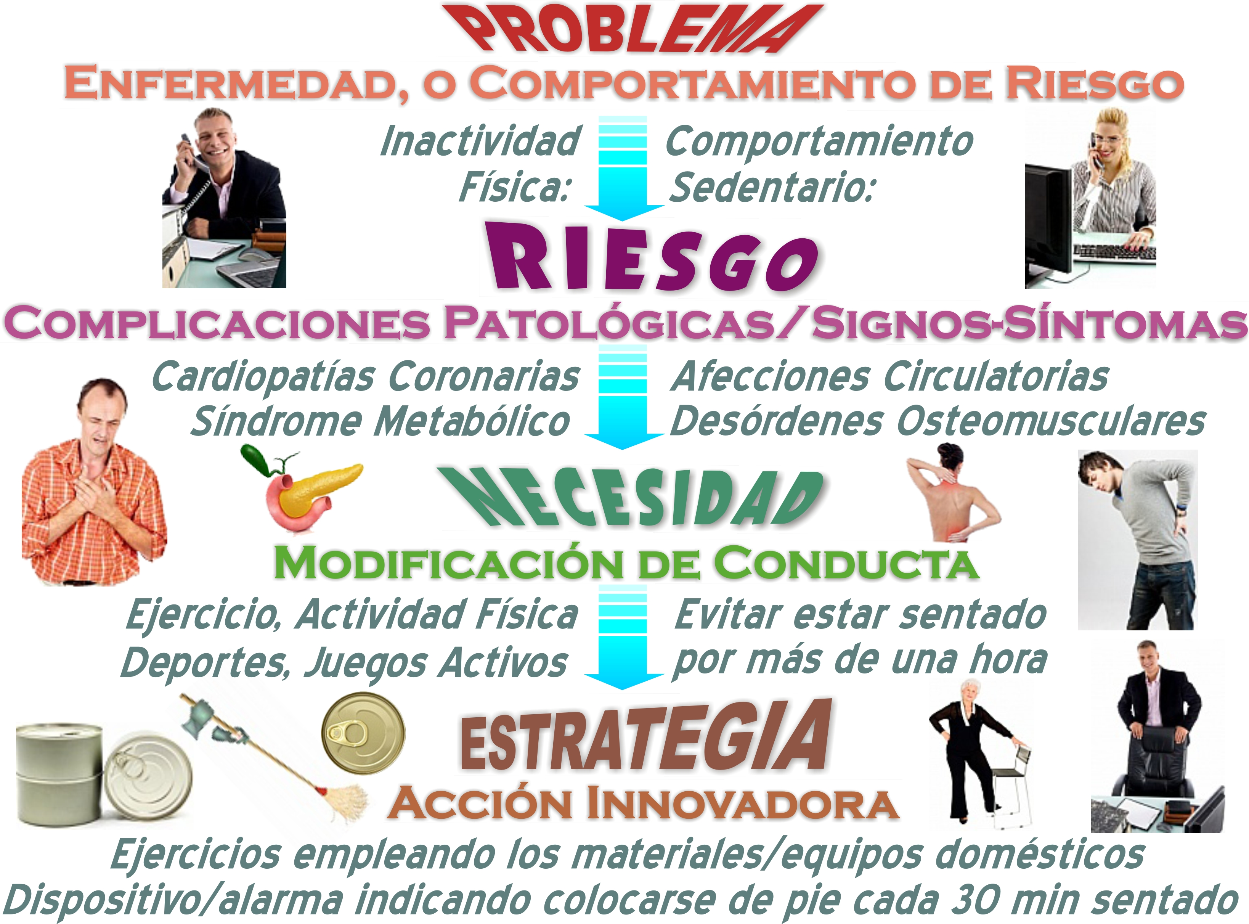
Notes:
52

Slide 53

Notes:
53

Slide 54
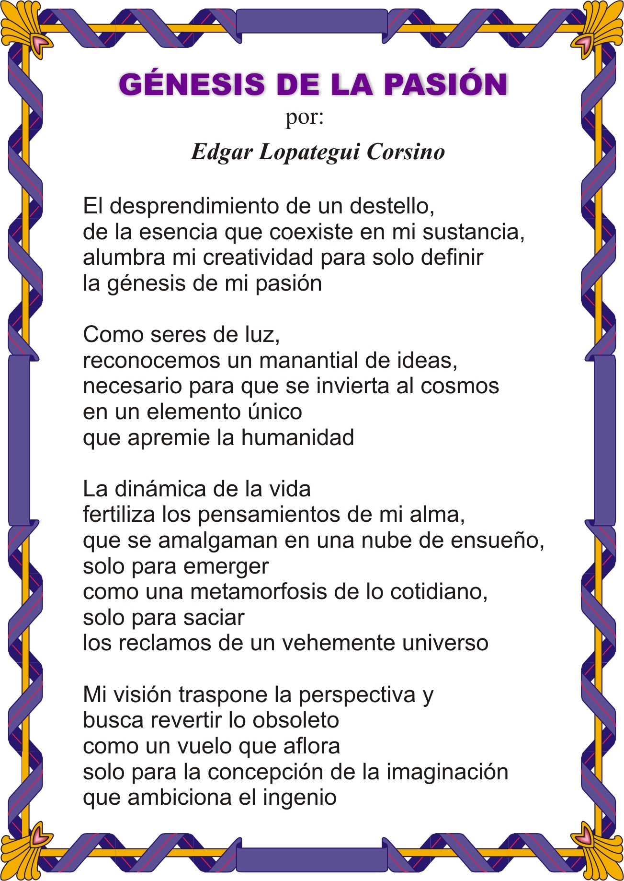
Notes:
54

Slide 55

Notes:
55

Slide 56

Notes:
56

